Slide 1
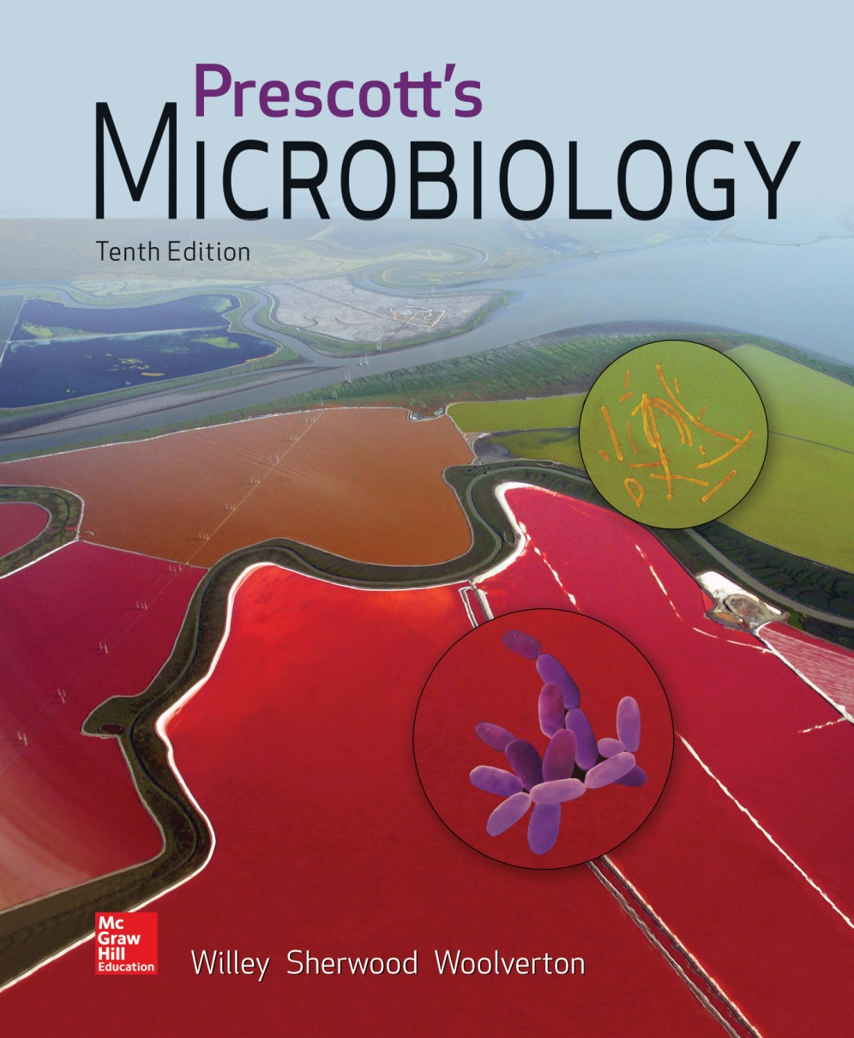
Chapter 3 – Bacterial Cell Structure

Slide 2
3.1 Use of the term “prokaryote” is controversial
List the characteristics originally used to describe prokaryotic cells
Form an opinion on the “prokaryote” controversy using current evidence about bacterial cells

Slide 3
3.2 Bacteria are diverse but share some common features
Distinguish a typical bacterial cell from a typical plant or animal cell in terms of cell shapes and arrangements, size, and cell structures
Discuss the factors that determine the size and shape of a bacterial cell.

Slide 4
Bacterial and Archaea Structure and Function
Prokaryotes differ from eukaryotes in size and simplicity
most lack internal membrane systems
term prokaryotes is becoming blurred
this text will use Bacteria and Archaea
this chapter will cover Bacteria and their structures

Slide 5
Size, Shape, and Arrangement
Shape
cocci and rods most common
various others
Arrangement
determined by plane of division
determined by separation or not
Size - varies

Slide 6
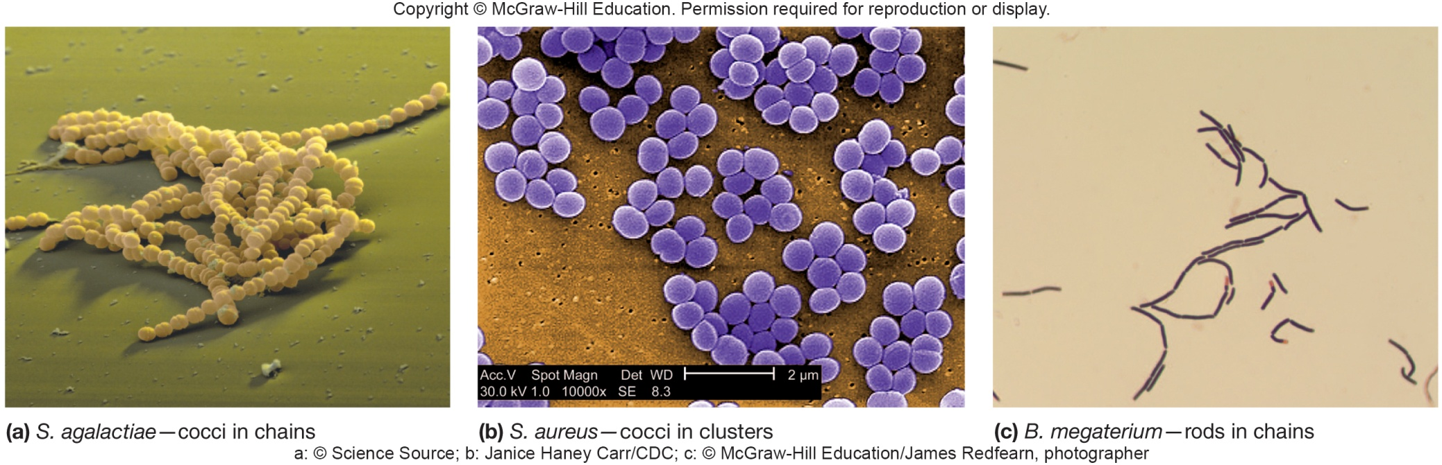
Cocci Shape and Arrangement
Cocci (s., coccus) – spheres
diplococci (s., diplococcus) – pairs
streptococci – chains
staphylococci – grape-like clusters
tetrads – 4 cocci in a square
sarcinae – cubic configuration of 8 cocci

Slide 7
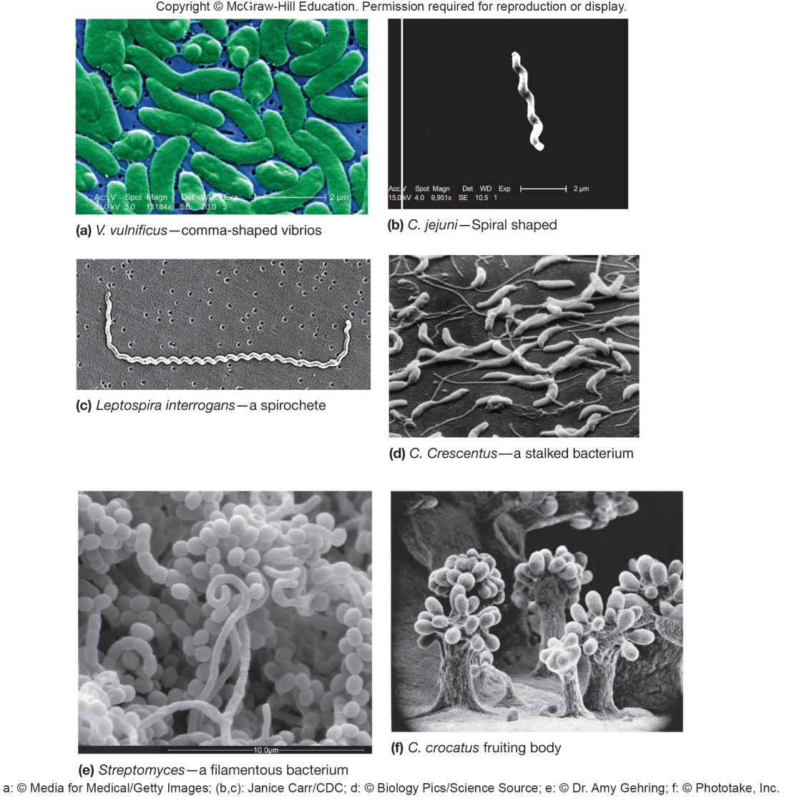
Other Shapes and Arrangements
Bacilli (s., bacillus) – rods
coccobacilli – very short rods
Vibrios – resemble rods, comma shaped
Spirilla (s., spirillum) – rigid helices
Spirochetes – flexible helices
Mycelium – network of long, multinucleate filaments
Pleomorphic – organisms that are variable in shape

Slide 8
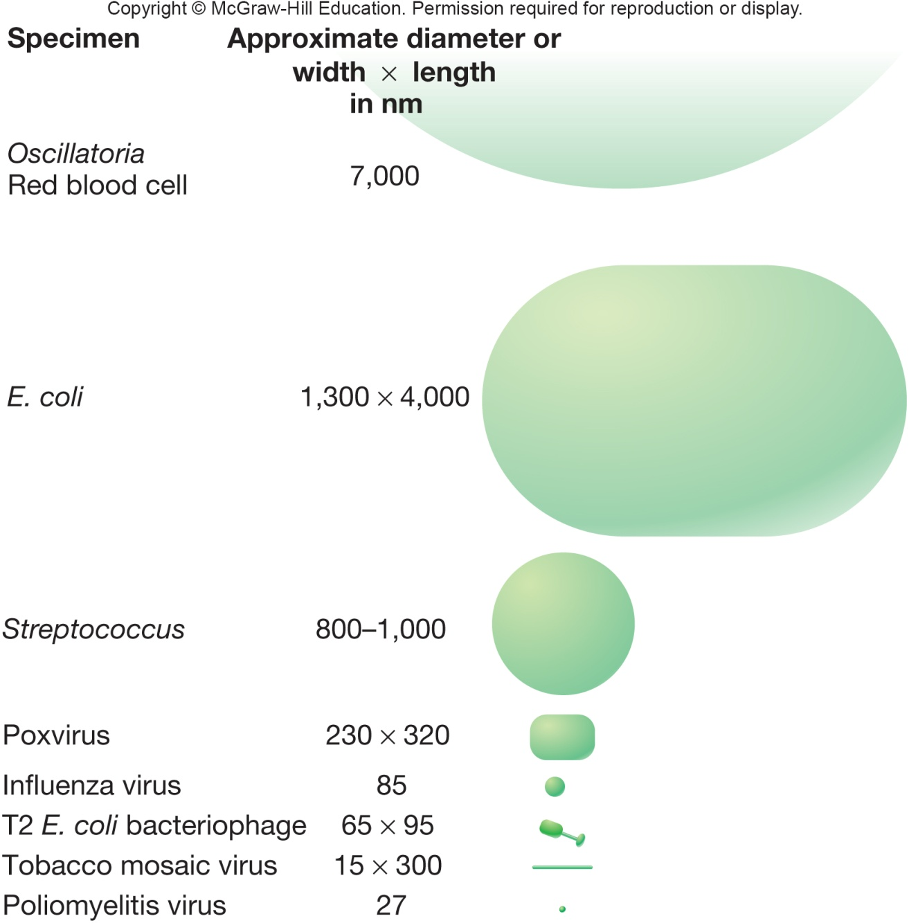
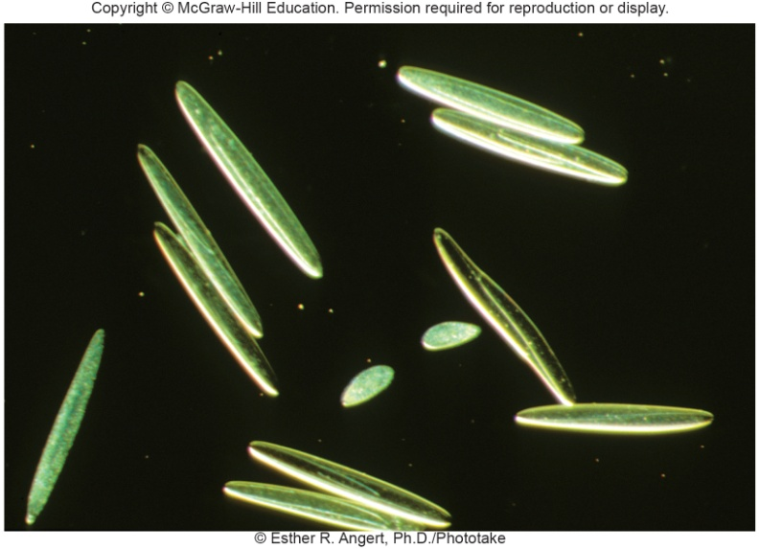
Size Smallest – 0.3 μm (Mycoplasma) Average rod – 1.1 - 1.5 x 2 – 6 μm (E. coli) Very large – 600 x 80 μm Epulopiscium fishelsoni

Slide 9
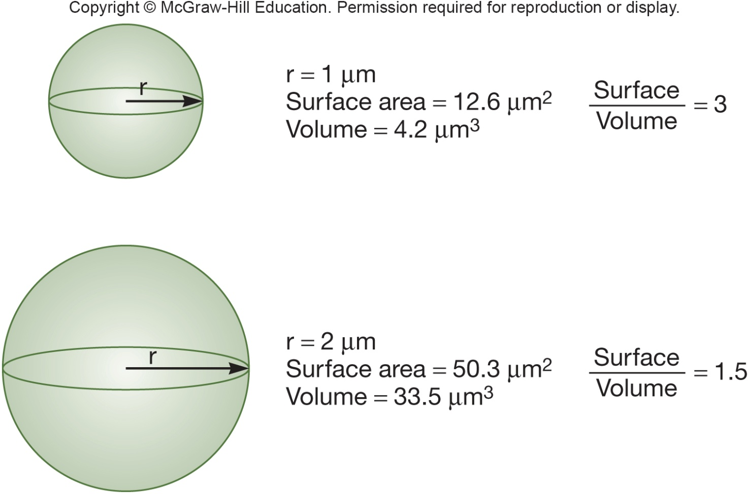
Size – Shape Relationship
Important for nutrient uptake
Surface to volume ratio (S/V)
Small size may be protective mechanism from predation

Slide 10
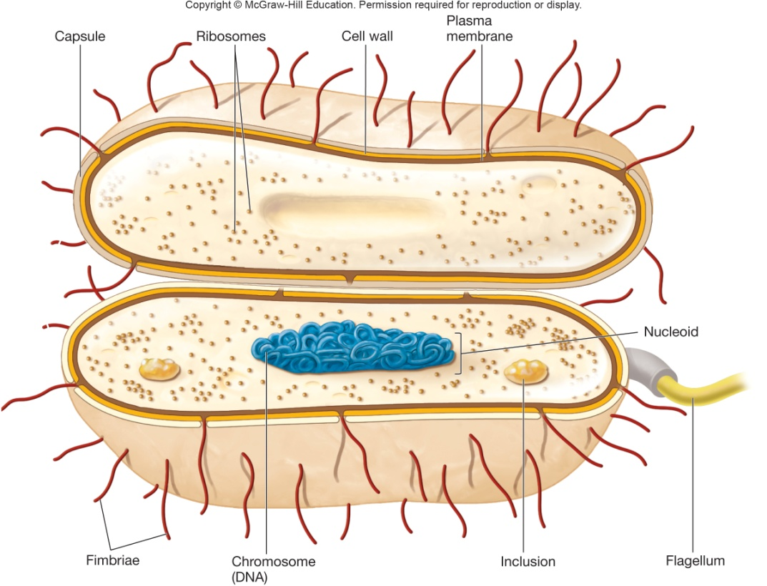
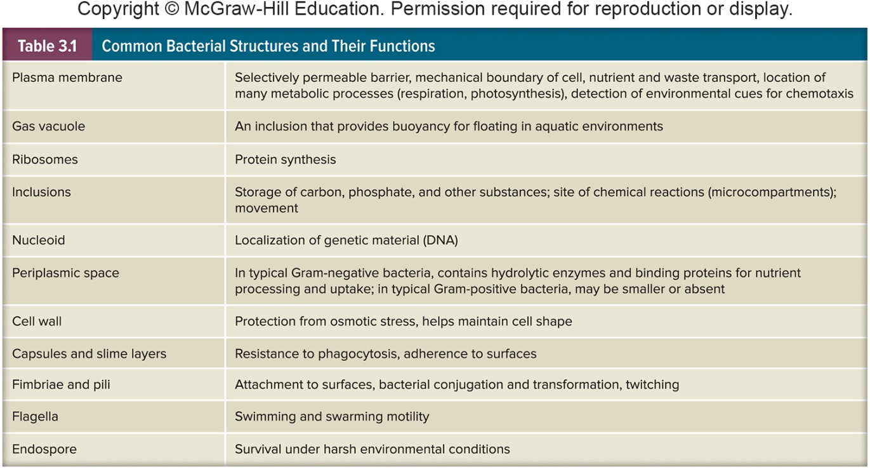
Bacterial Cell Organization – Common Features -Cell envelope – 3 layers -Cytoplasm -External structures

Slide 11
3.3 Bacterial plasma membranes control what enters and leaves the cell
Describe the fluid mosaic model of membrane structure and identify the types of lipids typically found in bacterial membranes.
Distinguish macroelements (macronutrients) from micronutrients (trace elements) and provide examples of each.
Provide examples of growth factors needed by some microorganisms.
Compare and contrast passive diffusion, facilitated diffusion, active transport, and group translocation, and provide examples of each.
Discuss the difficulty of iron uptake and describe how bacteria overcome this difficulty.

Slide 12
Bacterial Cell Envelope
Plasma membrane
Cell wall
Layers outside the cell wall

Slide 13
Plasma Membrane Functions
Encompasses the cytoplasm; absolute requirement for all living organisms
Selectively permeable barrier
Interacts with external environment
receptors for detection of and response to chemicals in surroundings
transport systems
metabolic processes

Slide 14
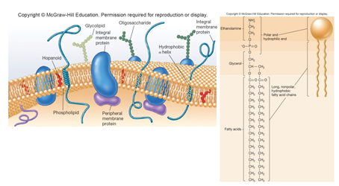
Fluid Mosaic Model of Membrane Structure
Lipid bilayers with floating proteins
amphipathic lipids
polar ends (hydrophilic – interact with water)
non-polar tails (hydrophobic – insoluble in water)
membrane proteins
peripheral
loosely connected to
membrane
easily removed
integral
amphipathic –
embedded within
membrane
carry out important functions

Slide 15
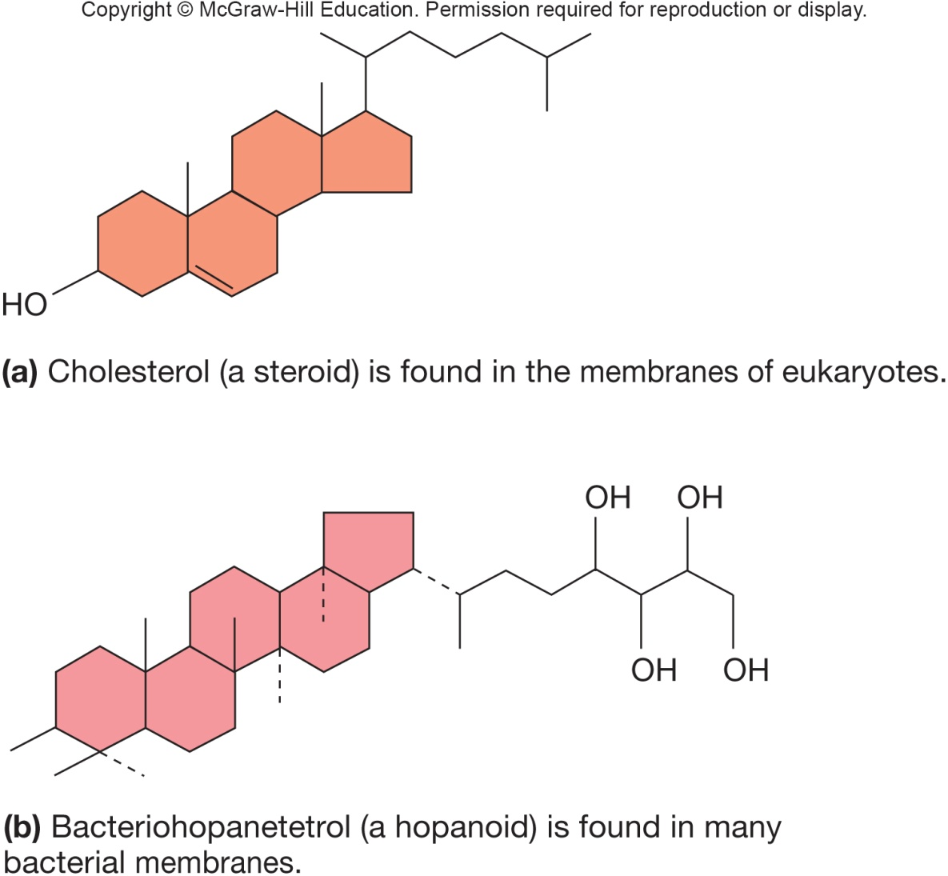
Bacterial Lipids
Saturation levels of membrane lipids reflect environmental conditions such as temperature
Bacterial membranes lack sterols but do contain sterol-like molecules, hopanoids
stabilize membrane
found in petroleum

Slide 16
Uptake of Nutrients –Through the Barrier
Macroelements (macronutrients)
C, O, H, N, S, P
found in organic molecules (proteins, lipids, carbohydrates, and nucleic acids)
K, Ca, Mg, and Fe
cations; serve in variety of roles including assisting enzymes and biosynthesis
required in relatively large amounts
Micronutrients (trace elements)
Mn, Zn, Co, Mo, Ni, and Cu; required in trace amounts
often supplied in water/media components; ubiquitous
Work to assist enzymes (cofactors)
Some unique substances may be required

Slide 17
Growth Factors – Through the Barrier
Growth factors
organic compounds
essential cell components (or their precursors) that the cell cannot synthesize
must be supplied by environment if cell is to survive and reproduce
classes include:
amino acids
needed for protein synthesis
purines and pyrimidines
needed for nucleic acid synthesis
vitamins
function as enzyme cofactors
heme

Slide 18
Methods for Uptake of Nutrients
Microbes can only take in dissolved particles across a selectively permeable membrane
Some nutrients enter by passive diffusion
Microorganisms use transport mechanisms
facilitated diffusion
active transport
group translocation

Slide 19
Passive Diffusion
Molecules move from region of higher concentration to one of lower concentration between the cell’s interior and the exterior
H₂O, O₂, and CO₂ often move across membranes this way

Slide 20
Facilitated Diffusion
Similar to passive diffusion
movement of molecules is not energy dependent
direction of movement is from high concentration to low concentration
size of concentration gradient impacts rate of uptake

Slide 21
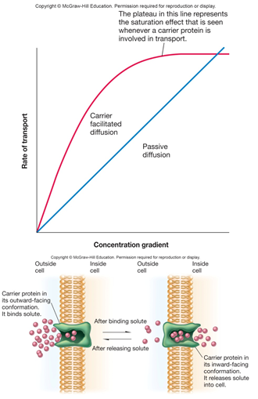
Facilitated vs. Passive Diffusion
Differs from passive diffusion
uses membrane bound carrier molecules (permeases)
smaller concentration gradient is required for significant uptake of molecules
effectively transports glycerol, sugars, and amino acids
More prominent in eukaryotic cells than in bacteria or archaea

Slide 22
Active Transport
Energy-dependent process
ATP or proton motive force used
Move molecules against the gradient
Concentrates molecules inside cell
Involves carrier proteins (permeases)
carrier saturation effect is observed at high solute concentrations

Slide 23
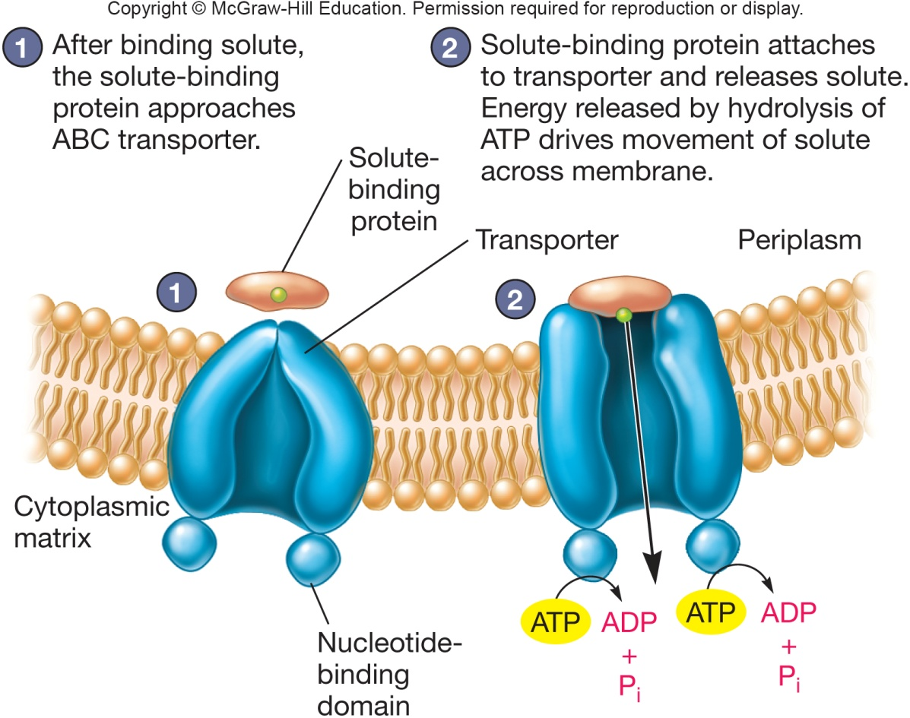
ABC Transporters
Primary active transporters use ATP
ATP-binding cassette (ABC) transporters
Observed in Bacteria, Archaea, and eukaryotes
Consist of
2 hydrophobic mem-
brane spanning
domains
2 cytoplasmic assoc-
iated ATP-binding
domains
substrate binding
domains

Slide 24
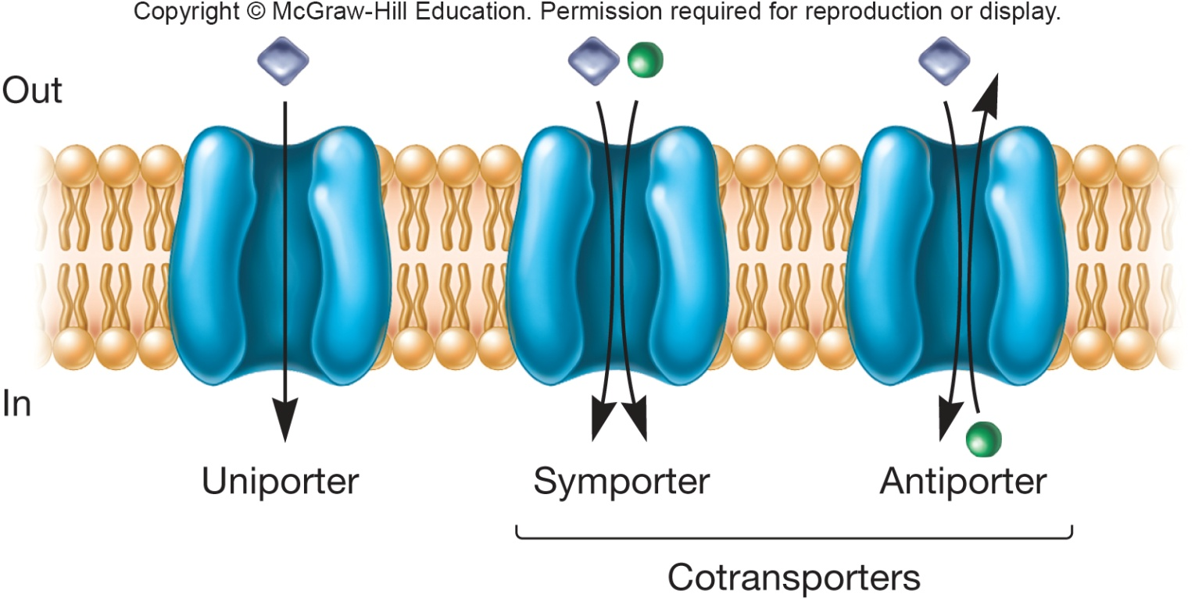
Secondary Active Transport
Major facilitator superfamily (MFS)
Use ion gradients to cotransport substances
protons
symport – two substances both move in the same direction
antiport – two substances move in opposite directions

Slide 25
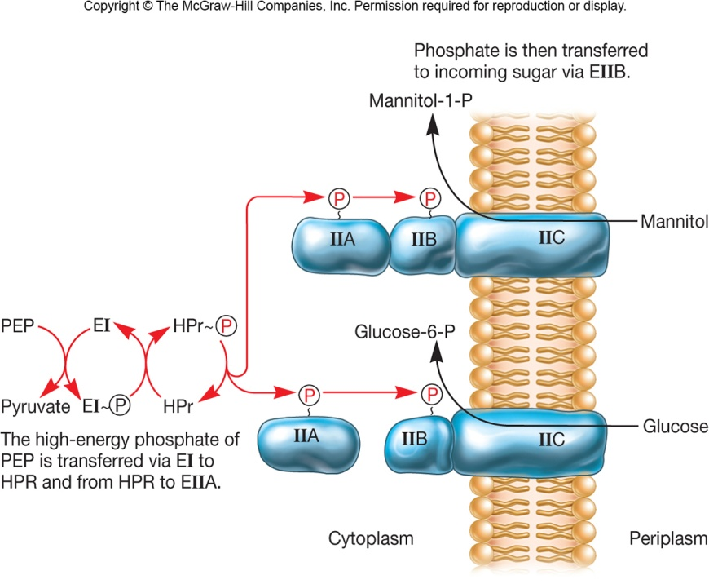
Group Translocation
Energy dependent transport that chemically modifies molecule as it is brought into cell
Best known translocation system is phosphoenolpyruvate: sugar phosphotransferase system (PTS)

Slide 26
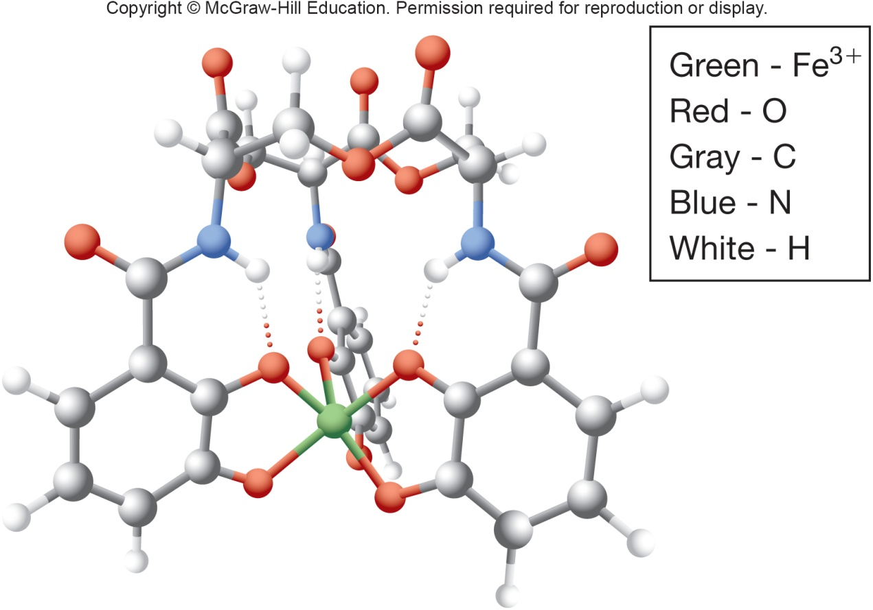
Iron Uptake
Microorganisms require iron
ferric iron is very insoluble so uptake is difficult
Microorganisms secrete siderophores to aid uptake
siderophore complexes with ferric ion
Complex is then transported into cell

Slide 27
3.4 There are two main types of bacterial cell walls
Describe peptidoglycan structure.
Compare and contrast the cell walls of typical Gram-positive and Gram-negative bacteria.
Relate bacterial cell wall structure to the Gram-staining reaction.

Slide 28
Bacterial Cell Wall
Cell wall functions
maintains shape of the bacterium
almost all bacteria have one
helps protect cell from osmotic lysis and toxic materials
may contribute to pathogenicity
Peptidoglycan (murein)
rigid structure lying just outside the cell plasma membrane
two types based on Gram stain
Gram-positive: stain purple; thick peptidoglycan
Gram-negative: stain pink or red; thin peptidoglycan and outer membrane

Slide 29
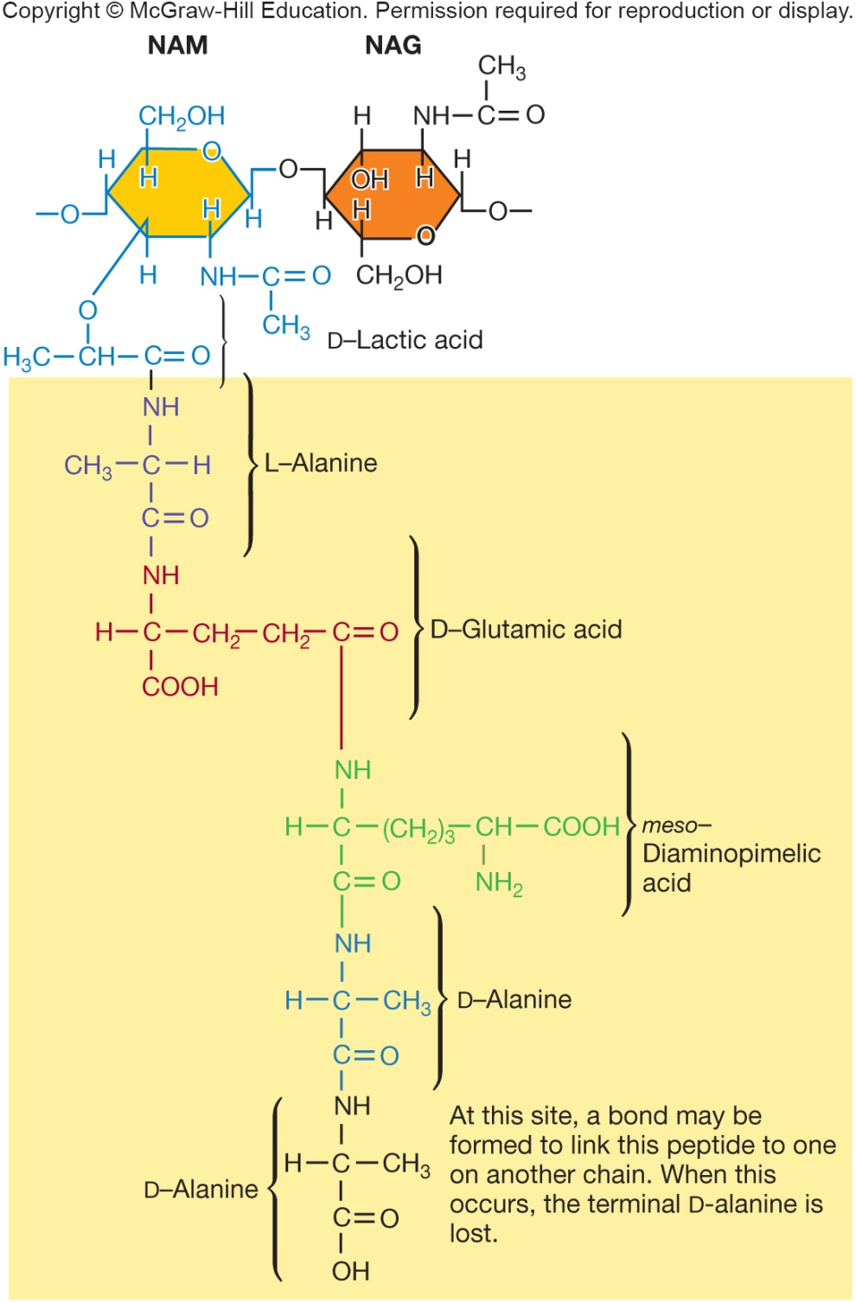
Peptidoglycan Structure
Meshlike polymer of identical subunits forming long strands
two alternating sugars
N-acetylglucosamine (NAG)
N- acetylmuramic acid
alternating D- and L- amino acids

Slide 30
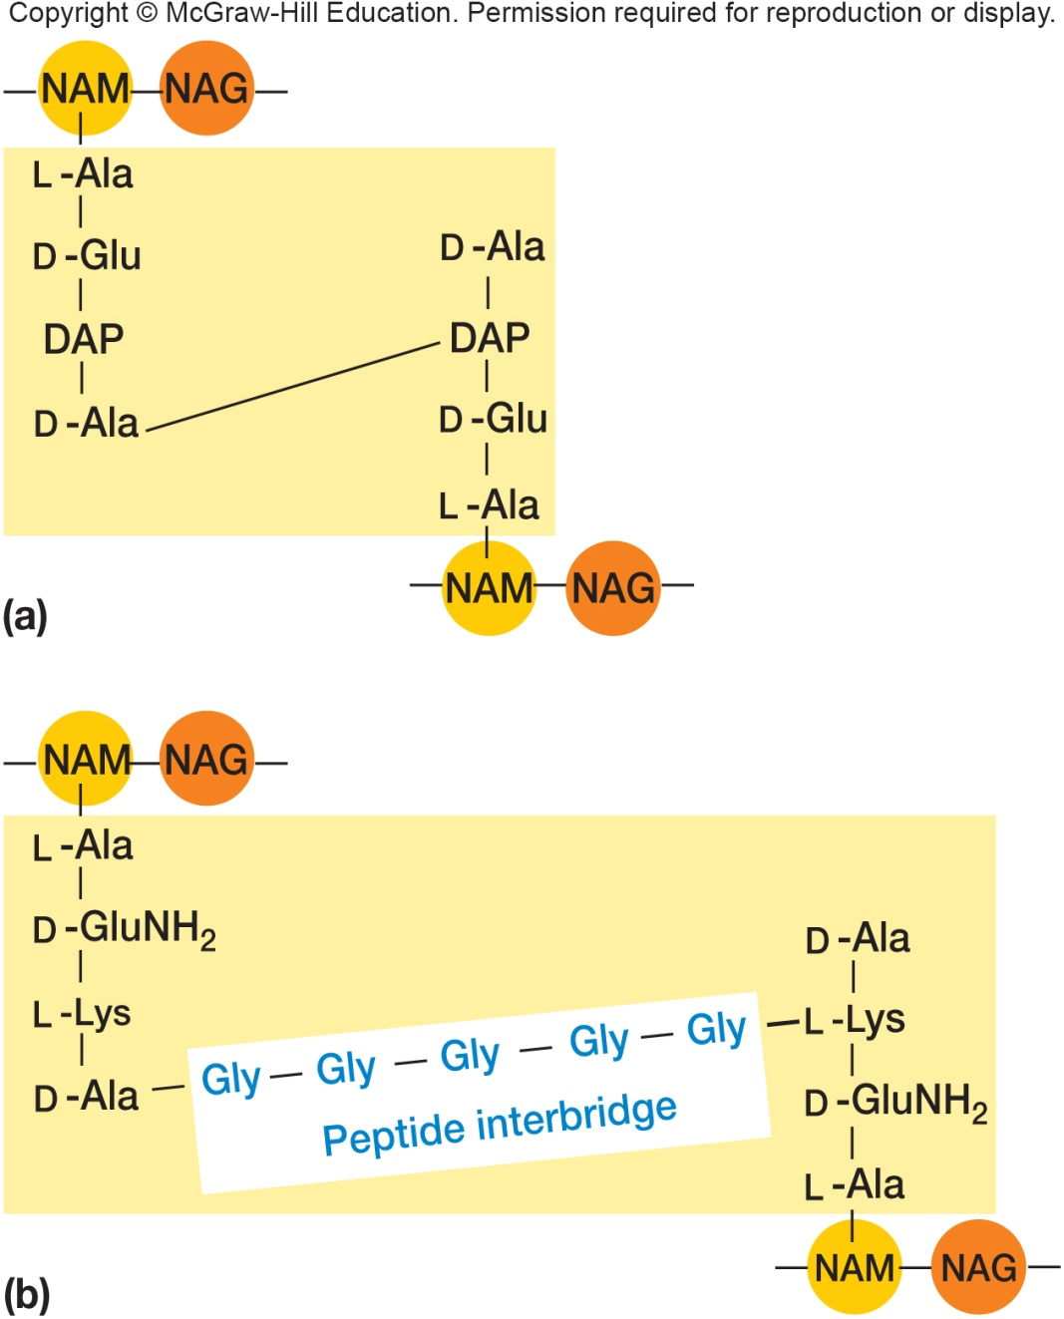
Strands Are Crosslinked
Peptidoglycan strands have a helical shape
Peptidoglycan chains are crosslinked by peptides for strength
interbridges may form
peptidoglycan sacs – interconnected networks
various structures occur

Slide 31
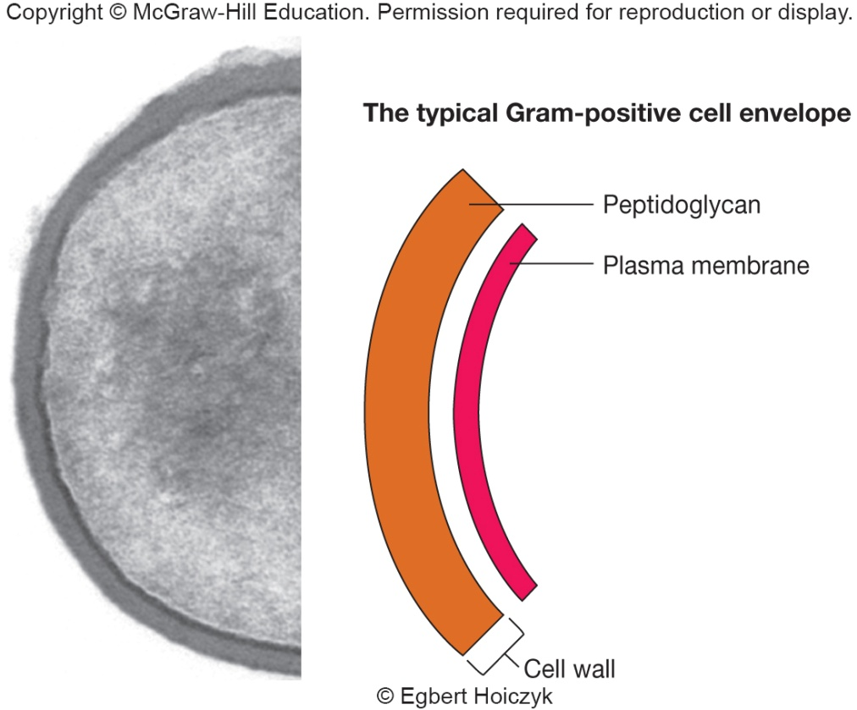
Gram-Positive Cell Walls
Composed primarily of peptidoglycan
May also contain teichoic acids (negatively charged)
help maintain cell envelope
protect from environmental substances
may bind to host cells
Some Gram-positive bacteria have layer of proteins on surface of peptidoglycan

Slide 32
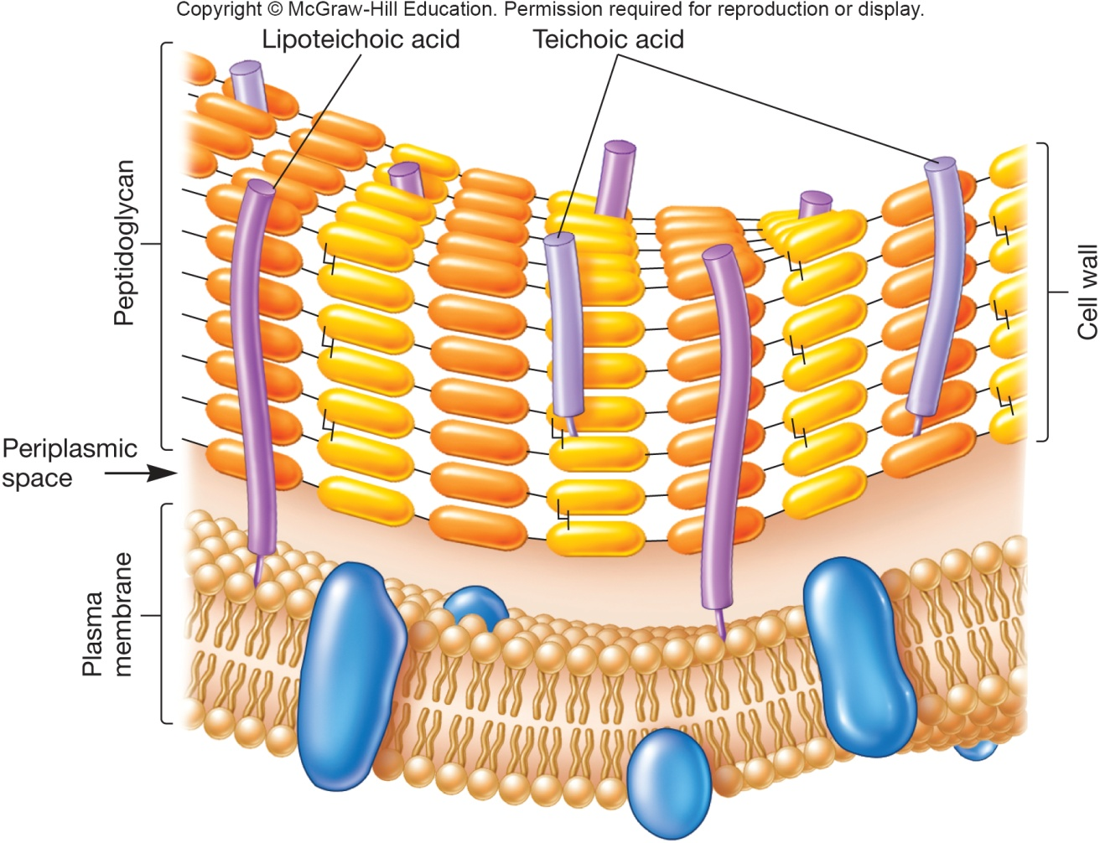
Periplasmic Space of Gram + Bacteria
Between plasma membrane and cell wall
Periplasm has relatively few proteins
Exoenzymes secreted by Gram-positive bacteria
aid in degradation of large nutrients

Slide 33
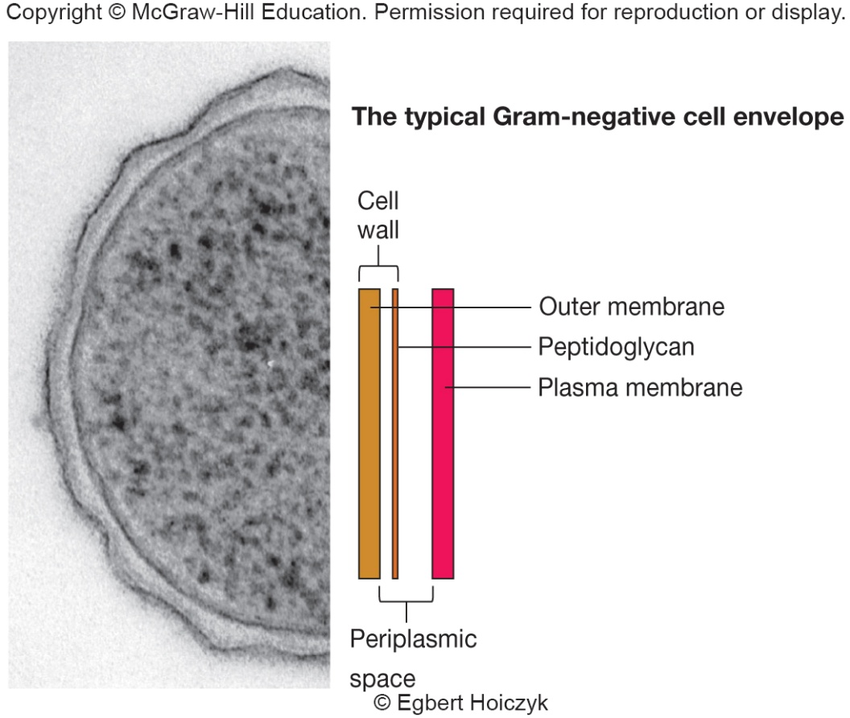
Gram-Negative Cell Wall Basic Structure
More complex than Gram-positive
Consist of a thin layer of peptidoglycan surrounded by an outer membrane
Outer membrane composed of lipids, lipoproteins, and lipopolysaccharide (LPS)
No teichoic acids

Slide 34
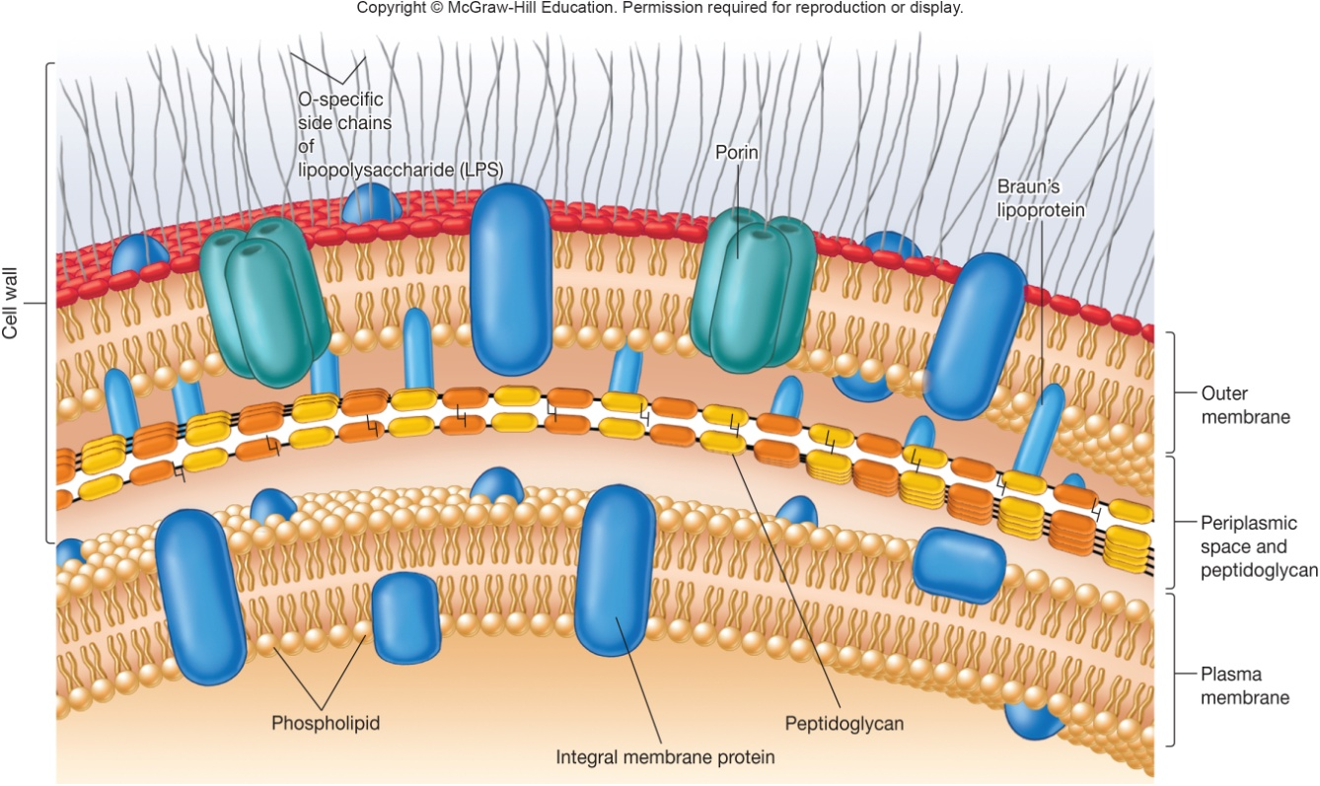
Gram-Negative Cell Walls
Outer membrane (OM) outside thin peptidoglycan layer
Braun’s lipoproteins connect OM to peptidoglycan
Other adhesion sites reported
Peptidoglycan is ~5-10% of cell wall weight
Periplasmic space differs from that in Gram-positive cells
may constitute
20–40% of cell
volume
many enzymes
present in periplasm
hydrolytic enzymes,
transport proteins
and other proteins

Slide 35
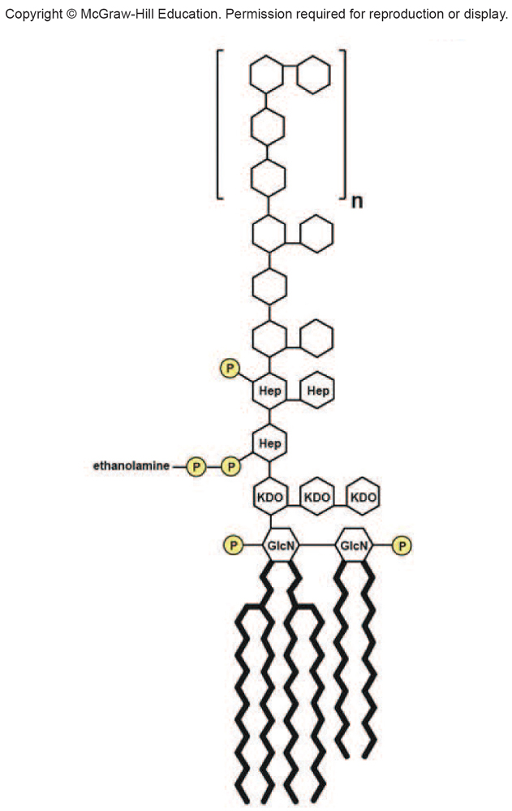
LPS - Lipopolysaccharide
Consists of three parts
lipid A
core polysaccharide
O side chain (O antigen)
Lipid A embedded in OM
Core polysaccharide, O side chain extend out from the cell

Slide 36
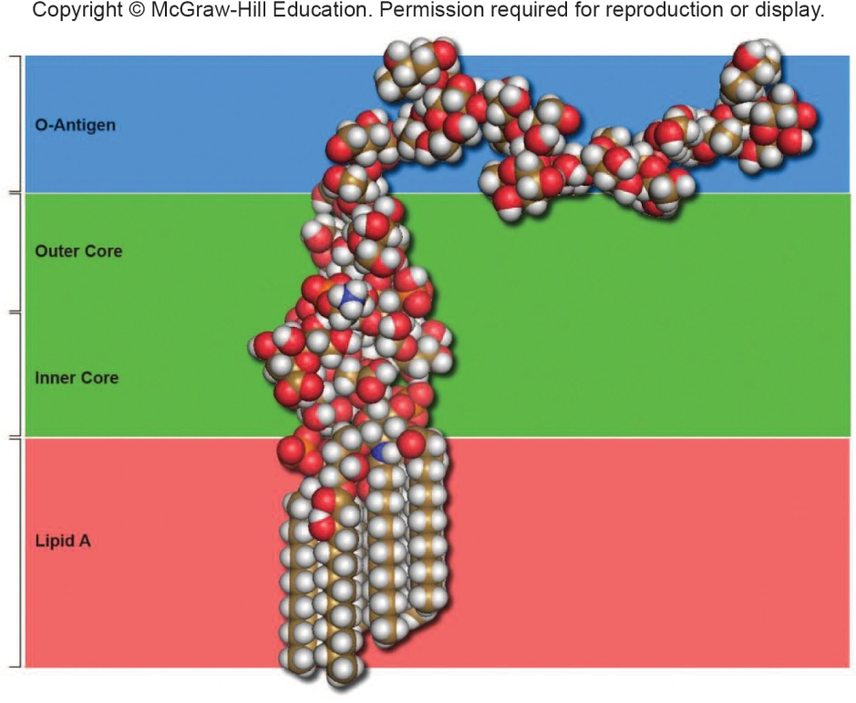
Importance of LPS
Contributes to negative charge on cell surface
Helps stabilize OM structure
Attachment to surfaces and biofilm formation
Creates a permeability barrier
Host defense protection (O antigen)
Acts as an endotoxin (lipid A)

Slide 37
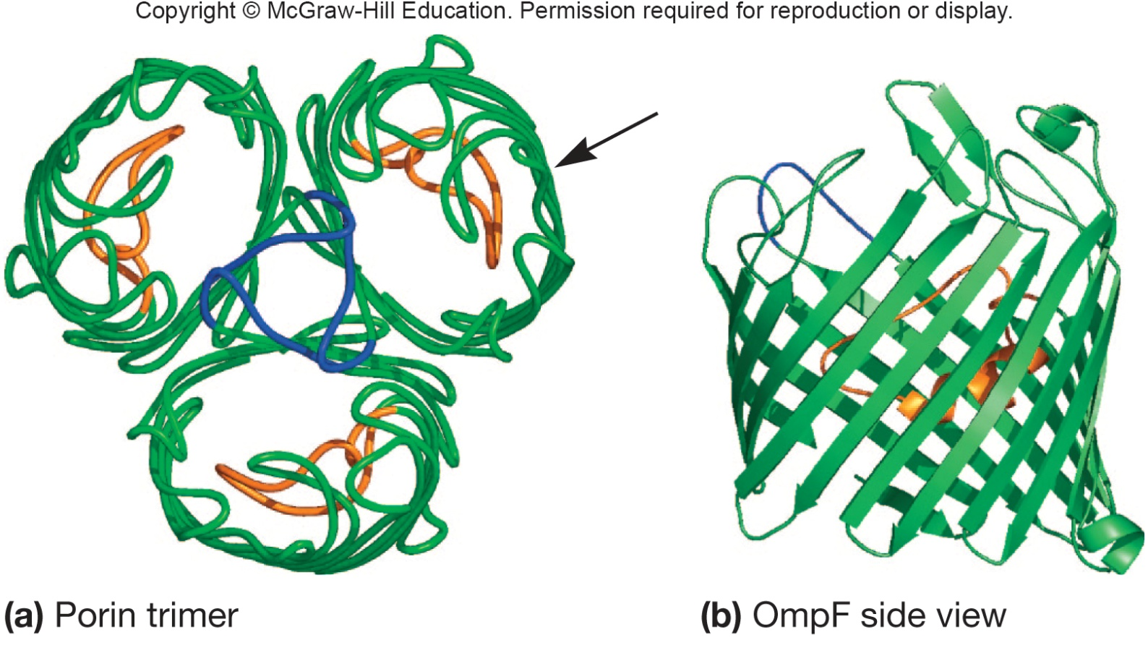
Gram-Negative Outer Membrane Permeability
More permeable than plasma membrane due to presence of porin proteins and transporter proteins
porin proteins form channels to let small molecules (600–700 daltons) pass

Slide 38
Mechanism of Gram Stain Reaction
Gram stain reaction due to nature of cell wall
Shrinkage of the pores of peptidoglycan layer of Gram-positive cells
constriction prevents loss of crystal violet during decolorization step
Thinner peptidoglycan layer and larger pores of Gram-negative bacteria does not prevent loss of crystal violet
alcohol may also remove/extract some lipids from outer layer of Gram-negative cell wall, making crystal violet dye removal easier

Slide 39
Osmotic Protection
Hypotonic environments
solute concentration outside cell less than inside cell
water moves into cell and cell swells
cell wall protects from lysis
Hypertonic environments
solute concentration outside cell is greater than inside
water leaves cell
plasmolysis occurs

Slide 40
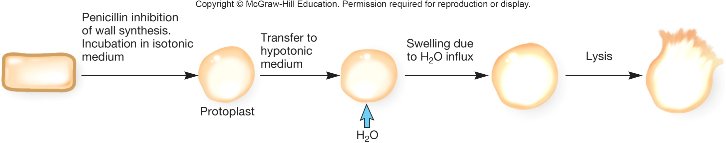
Evidence for protection of cell wall
Lysozyme breaks bond between NAG and NAM
Penicillin inhibits peptidoglycan synthesis
If cells are treated with either of the above, they lyse in a hypotonic solution

Slide 41
Cells that Lose a Cell Wall May Survive in Isotonic Environments
Protoplasts
Spheroplasts
Mycoplasma
does not produce a cell wall
plasma membrane more resistant to osmotic pressure

Slide 42
3.5 The Cell Envelope Often Includes Layers Outside the Cell Wall
Compile a list of the structures found in all the layers of bacterial cell envelopes, noting the functions and the major component molecules of each.

Slide 43
Components Outside of the Cell Wall
Outermost layer in the cell envelope
Glycocalyx
capsules and slime layers
S layers
Aid in attachment to solid surfaces
e.g. biofilms in plants and animals

Slide 44
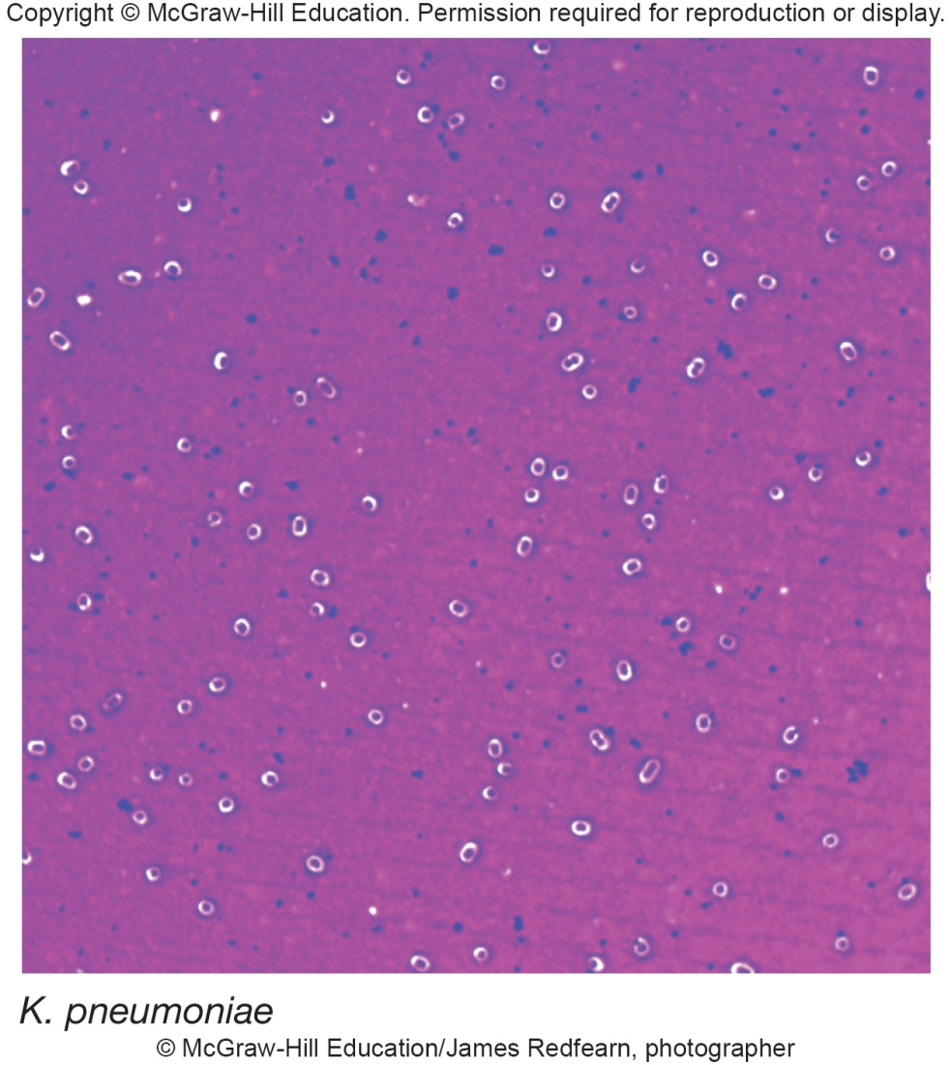
Components Outside of Cell Wall - Capsules
Usually composed of polysaccharides
Well organized and not easily removed from cell
Visible in light microscope
Protective advantages
resistant to phagocytosis
protect from desiccation
exclude viruses and detergents

Slide 45
Components Outside of Cell Wall - Slime Layers
Similar to capsules except diffuse, unorganized and easily removed
Slime may aid in motility

Slide 46
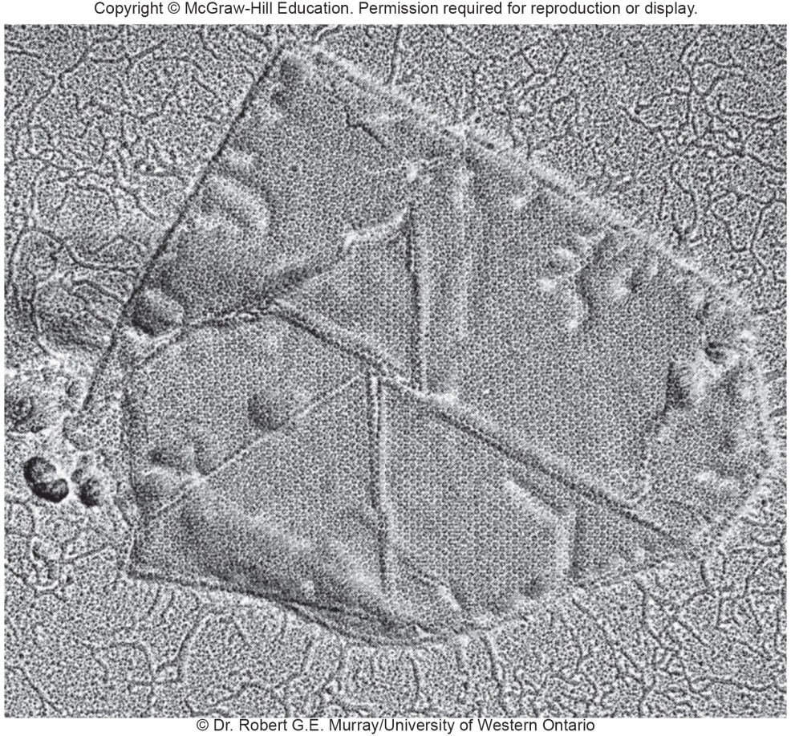
Components Outside of Cell Wall - S Layers
Regularly structured self-assembling layers of protein or glycoprotein
in Gram-negative bacteria S layer adheres to outer membrane
in Gram-positive bacteria, associated with peptidoglycan
S Layer functions
protect from ion and pH fluctuations, osmotic stress, enzymes, and predation
maintains shape and rigidity
promotes adhesion to surfaces
protects from host defenses
potential use in nanotechnology
S layer spontaneously associates

Slide 47
3.6 The Bacterial Cytoplasm Is More Complex Than Once Thought
Create a table or concept map that identifies the components of the bacterial cytoplasm and describes their structure, molecular makeup, and functions.

Slide 48
Bacterial Cytoplasmic Structures
Cytoskeleton
Intracytoplasmic membranes
Inclusions
Ribosomes
Nucleoid and plasmids

Slide 49
Protoplast and Cytoplasm
Protoplast is plasma membrane and everything within
Cytoplasm - material bounded by the plasmid membrane

Slide 50
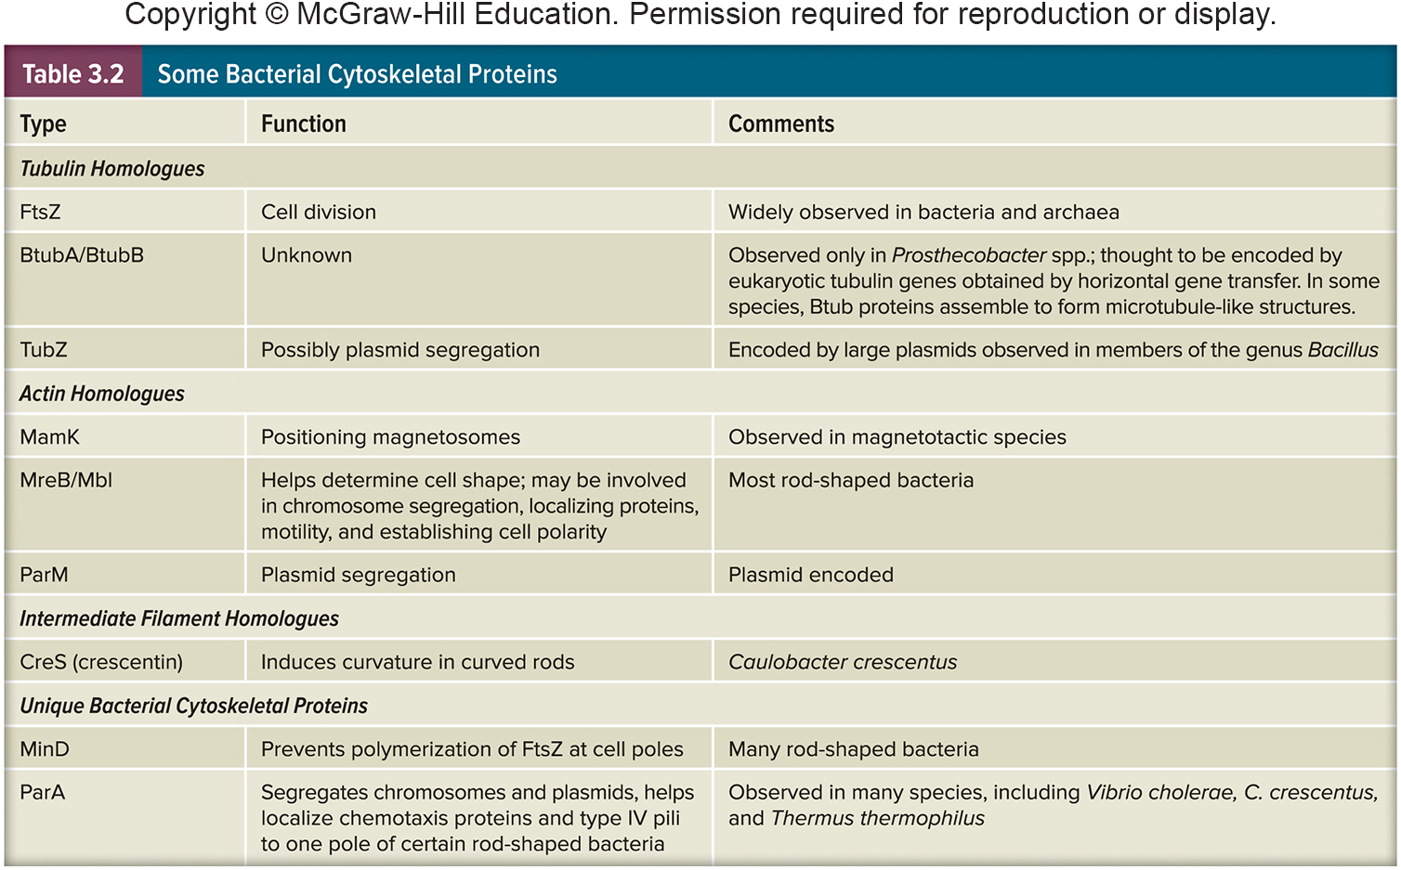
The Bacterial Cytoskeleton
Homologs of all 3 eukaryotic cytoskeletal elements have been identified in bacteria
Functions are similar as in eukaryotes

Slide 51
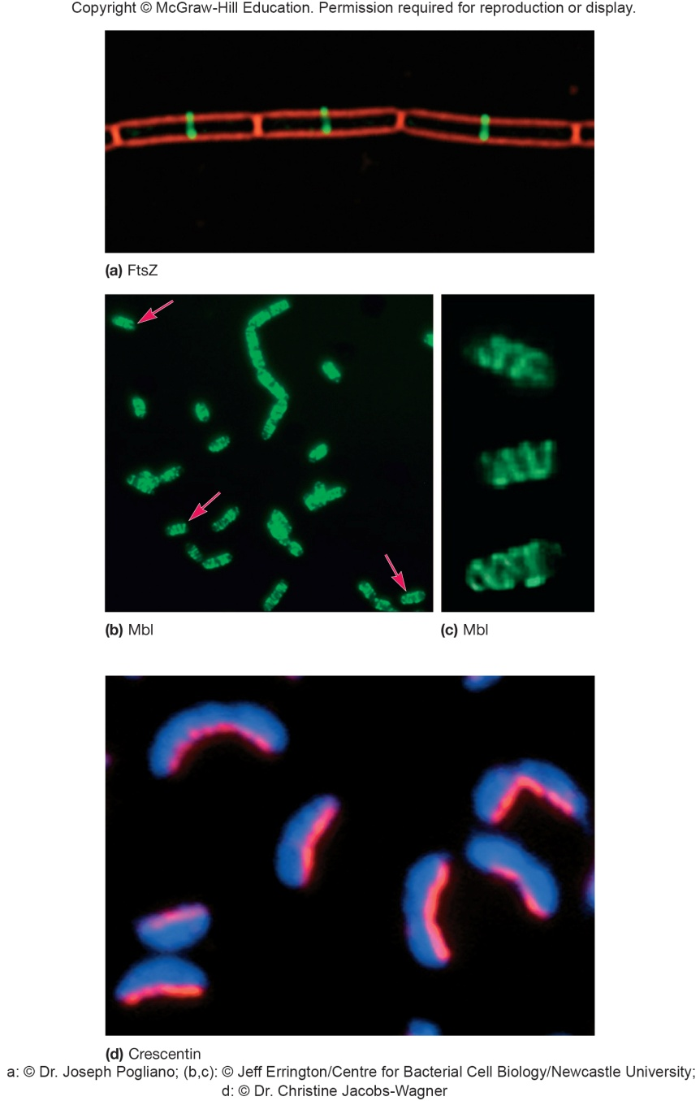
Best Studied Examples of Bacterial Cytoskeleton Molecules
FtsZ – many bacteria
forms ring during septum formation in cell division
MreB – many rods
maintains shape by
positioning peptidoglycan
synthesis machinery
CreS – rare, maintains
curve shape

Slide 52
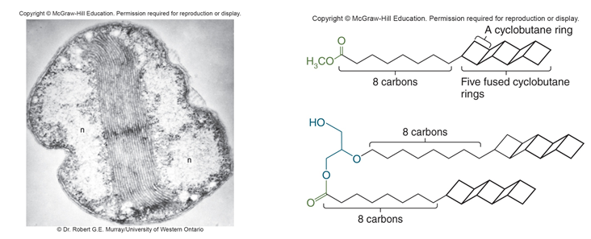
Intracytoplasmic Membranes
Plasma membrane infoldings
observed in many photosynthetic bacteria
observed in many bacteria with high respiratory activity
Anammoxosome in Planctomycetes
organelle – site of anaerobic ammonia oxidation

Slide 53
Inclusions
Granules of organic or inorganic material that are stockpiled by the cell for future use
Some are enclosed by a single-layered membrane
membranes vary in composition
some made of proteins; others contain lipids
may be referred to as microcompartments

Slide 54
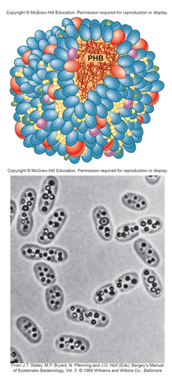
Storage Inclusions
Storage of nutrients, metabolic end products, energy, building blocks
Glycogen storage
Carbon storage
poly-β-hydroxybutyrate (PHB)
Phosphate - Polyphosphate (Volutin)
Amino acids - cyanophycin granules

Slide 55
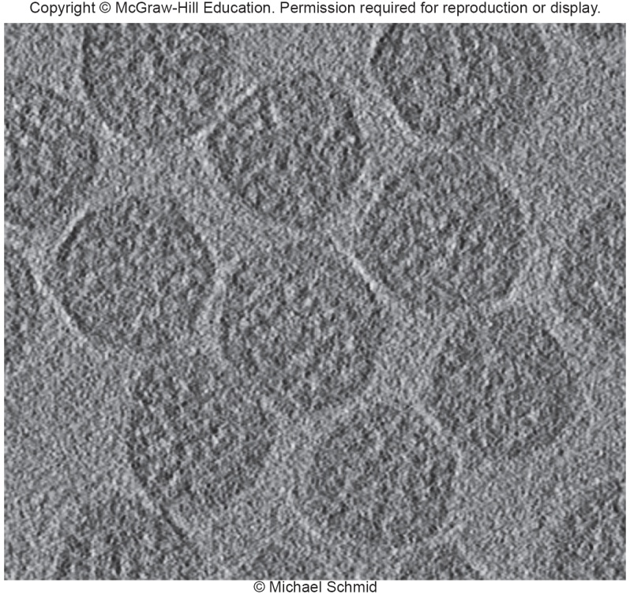
Microcompartments
Not bound by membranes but compartments for specific functions
Carboxysomes - CO₂ fixing bacteria
contain the enzyme Rubisco for CO₂ fixation

Slide 56
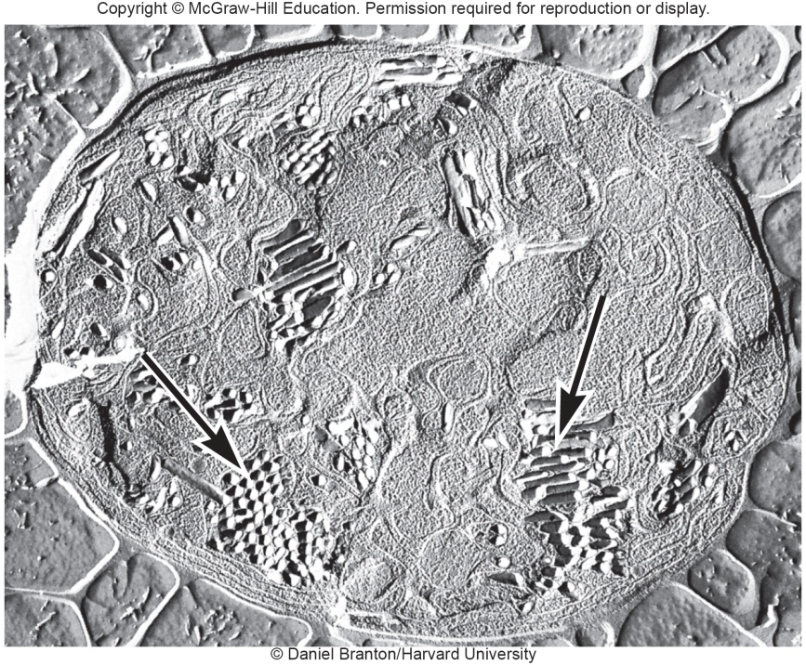
Gas Vacuoles
Found in aquatic, photosynthetic bacteria and archaea
Provide buoyancy in gas vesicles

Slide 57
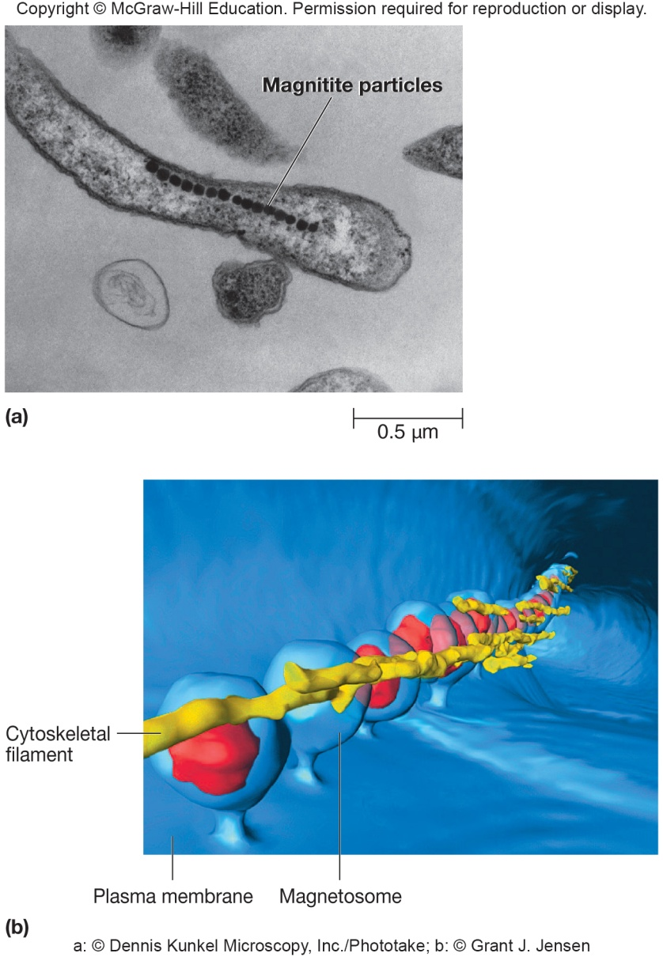
Magnetosomes
Found in aquatic bacteria
Magnetite particles for orientation in Earth’s magnetic field
Cytoskeletal protein MamK
helps form magnetosome chain

Slide 58
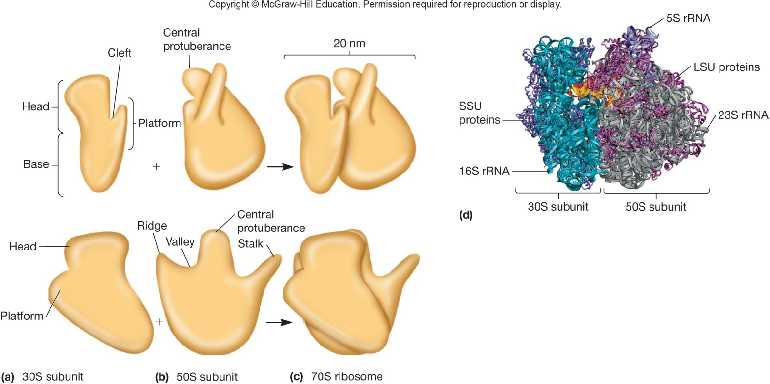
Ribosomes
Complex protein/RNA structures
sites of protein synthesis
bacterial and archaea ribosome = 70S
eukaryotic (80S) S = Svedburg unit
Bacterial ribosomal RNA
16S small subunit
23S and 5S in large subunit

Slide 59
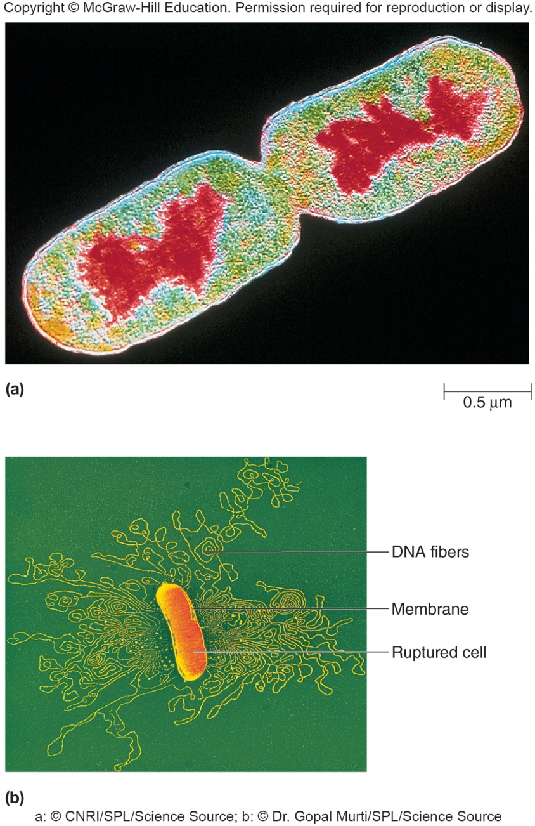
The Nucleoid
Usually not membrane bound (few exceptions)
Location of chromosome and associated proteins
Usually 1 closed circular, double-stranded DNA molecule
Supercoiling and nucleoid proteins (different from histones) aid in folding

Slide 60
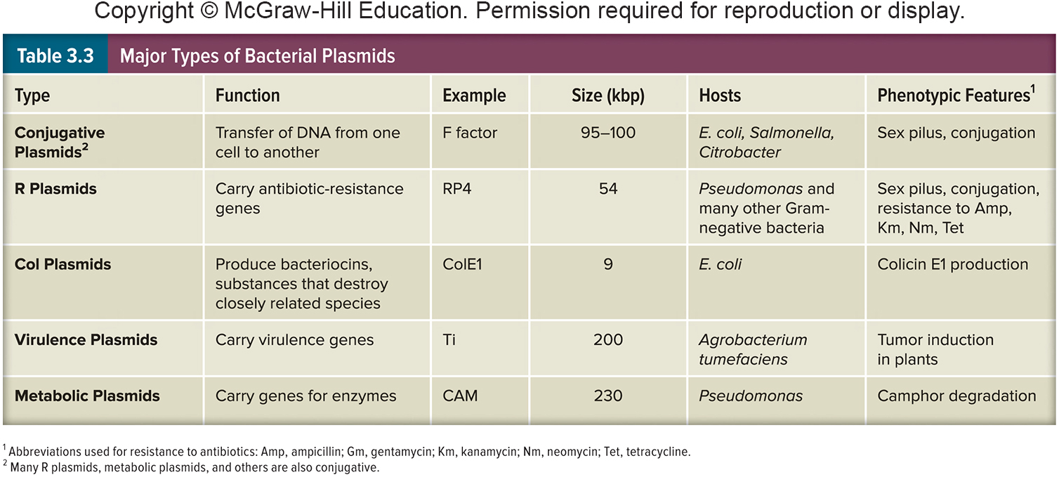
Plasmids
Extrachromosomal DNA
found in bacteria, archaea, some fungi
usually small, closed circular DNA molecules
Exist and replicate independently of chromosome
episomes – may integrate into chromosome
inherited during cell division
Classification via mode of existence, spread, and function

Slide 61
3.7 Many Bacteria Have External Structures Used For Attachment and Motility
Distinguish pili (fimbriae) and flagella.
Illustrate the various patterns of flagella distribution.

Slide 62
External Structures
Extend beyond the cell envelope in bacteria
Function in protection, attachment to surfaces, horizontal gene transfer, cell movement
pili and fimbriae
flagella

Slide 63
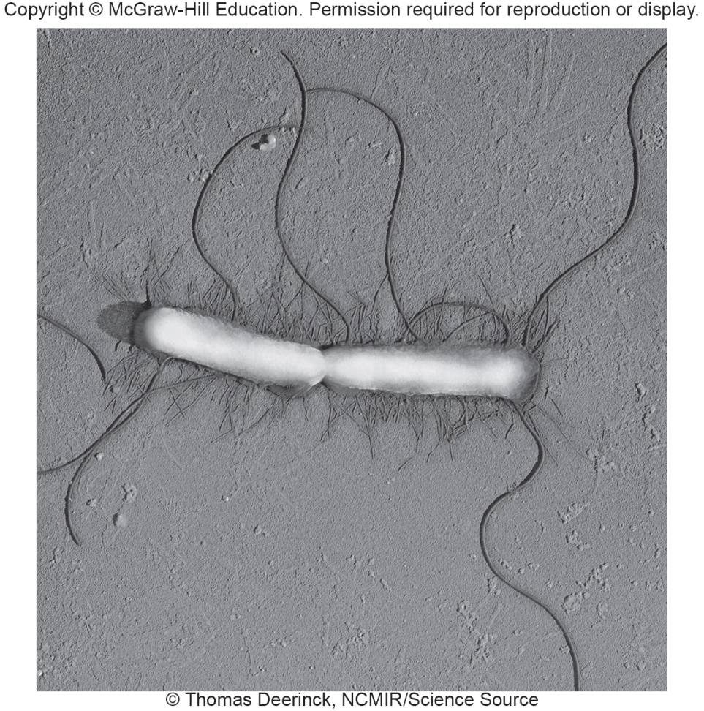
Pili and Fimbriae
Fimbriae (s., fimbria); pili (s., pilus)
short, thin, hairlike, protein appendages (up to 1,000/cell)
can mediate attachment to surfaces, motility, DNA uptake
Sex pili (s., pilus)
longer, thicker, less numerous (1-10/cell)
genes for formation on plasmids
required for conjugation

Slide 64
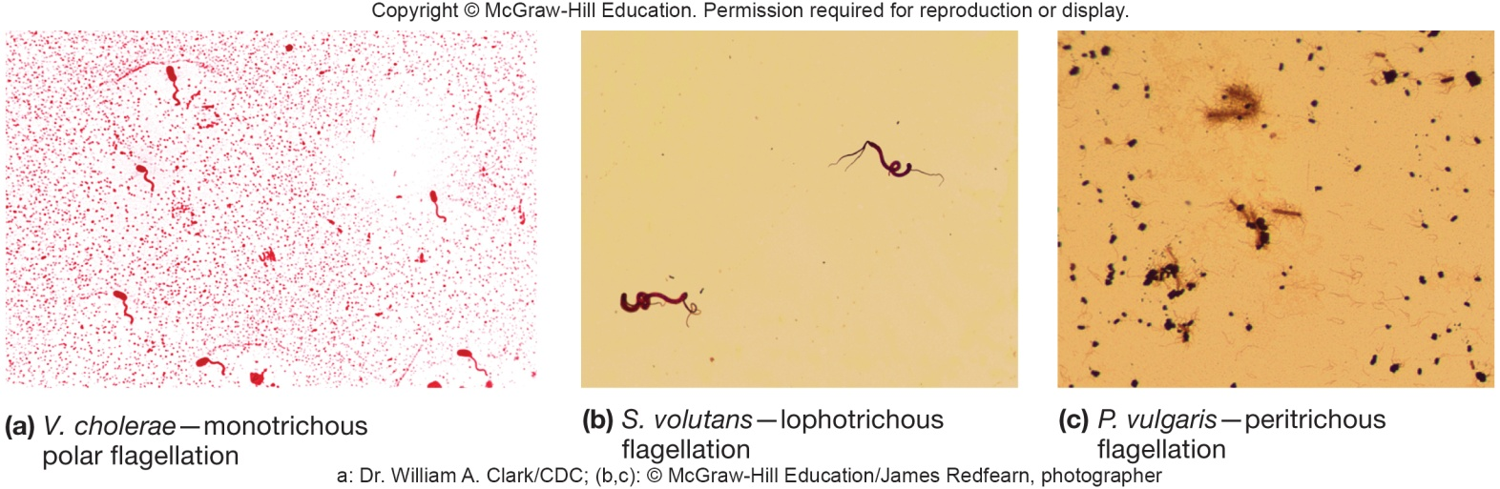
Flagella
Threadlike, locomotor appendages extending outward from plasma membrane and cell wall
Functions
motility and swarming behavior
attachment to surfaces
may be virulence factors
Patterns of flagellation
monotrichous – one flagellum
polar flagellum – flagellum at end of cell
amphitrichous – one flagellum at each end of cell
lophotrichous – cluster of flagella at one or both ends
peritrichous – spread over entire surface of cell

Slide 65
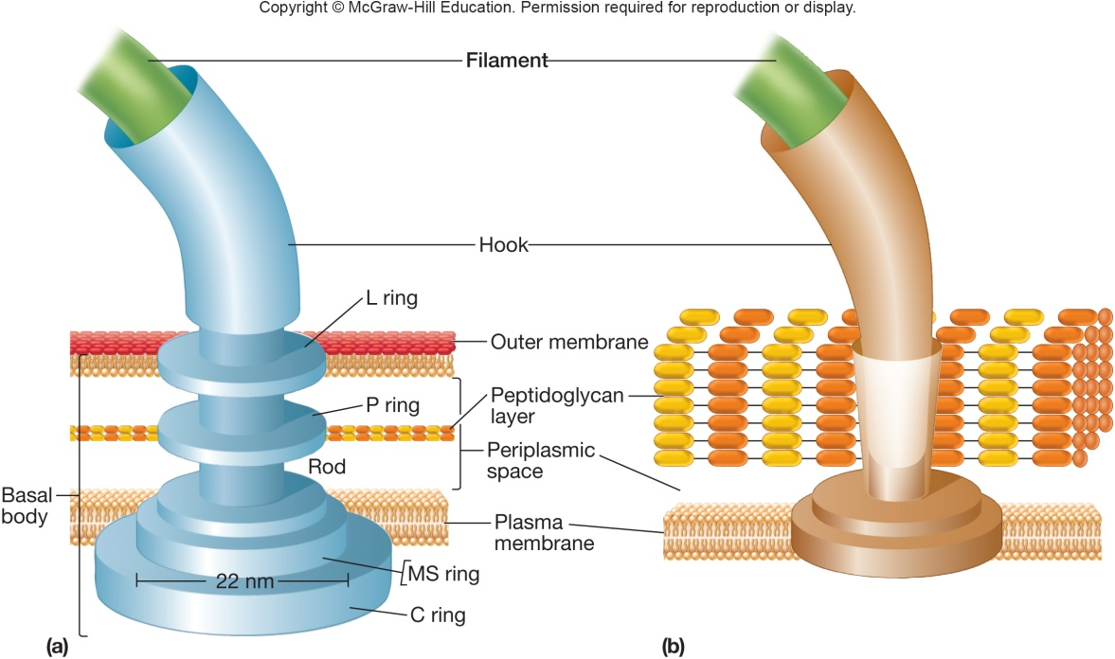
Bacterial Flagella
Thin, rigid protein structures that cannot be observed with bright-field microscope unless specially stained
Ultrastructure composed of three parts
filament extends from cell surface to the tip
hollow, rigid cylinder of flagellin protein
hook links filament to basal body
basal body is series of rings that drive flagellar motor

Slide 66
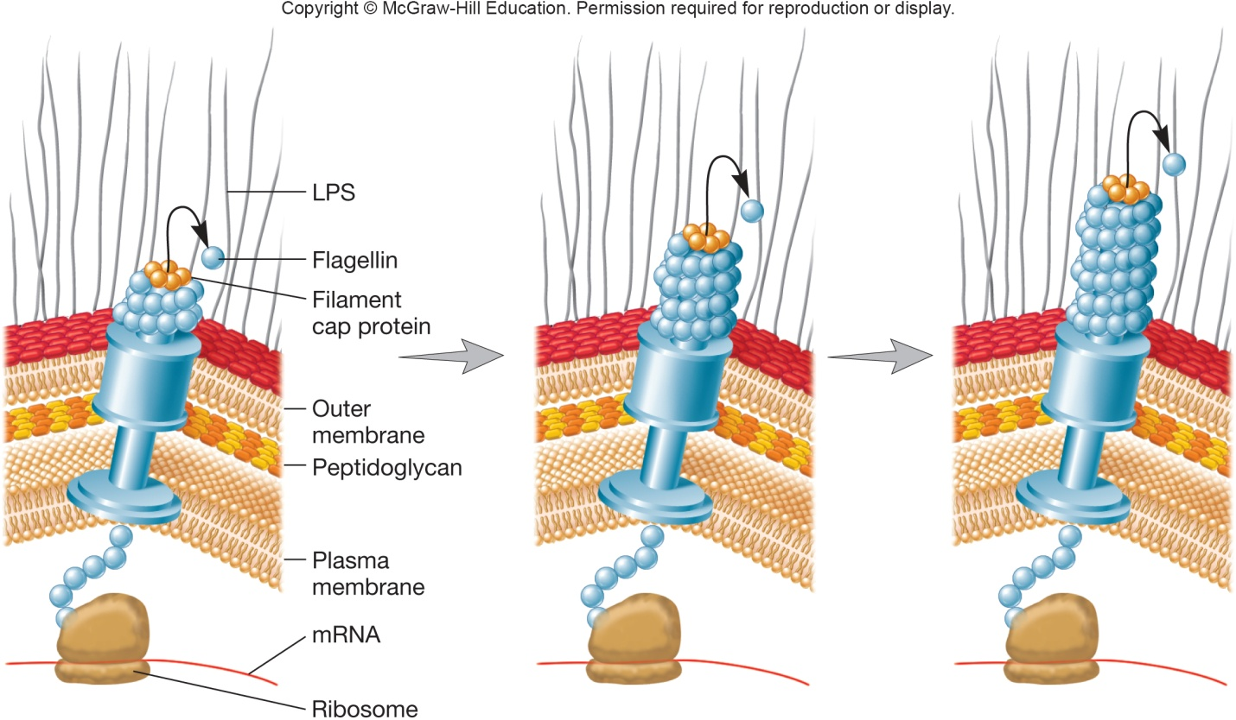
Flagellar Synthesis
Complex process involving many genes/gene products
New flagellin molecules transported through the hollow filament using Type III-like secretion system
Filament subunits self-assemble with help of filament cap at tip, not base

Slide 67
3.8 Bacterial Move in Response to Environmental Conditions
Compare and contrast flagellar swimming motility, spirochete flagellar motility, and twitching and gliding motility.
State the source of energy that powers flagellar motility.
Explain why bacterial chemotaxis is referred to as a “biased random walk.”

Slide 68
Motility
Flagellar movement
Swarming
Spirochete motility
Twitching motility
Gliding motility
Bacteria and Archaea have directed movement
Chemotaxis
move toward chemical attractants such as nutrients, away from harmful substances
Move in response to temperature, light, oxygen, osmotic pressure, and gravity

Slide 69
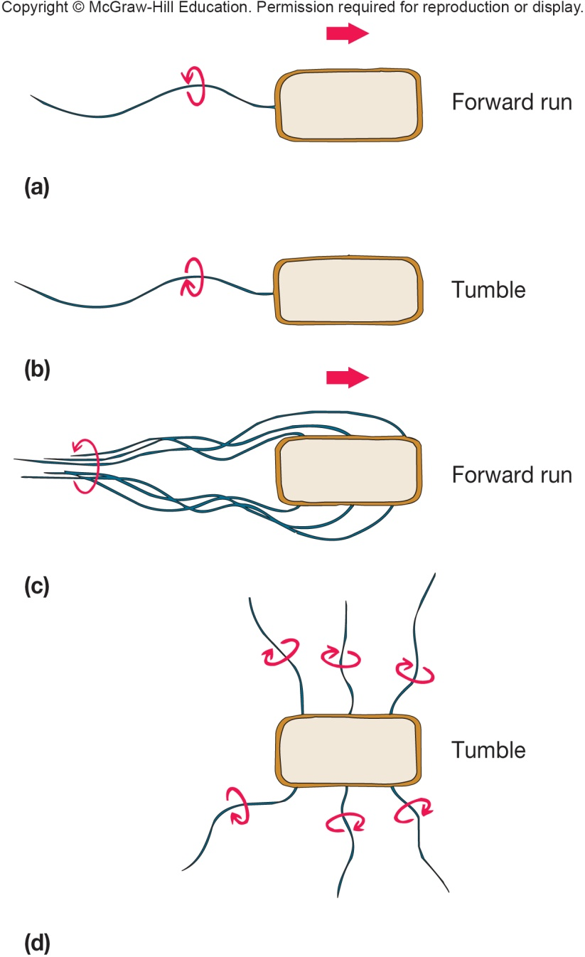
Bacterial Flagellar Movement
Flagellum rotates like a propeller
very rapid rotation up to
1100 revolutions/sec
in general, counterclockwise (CCW) rotation causes forward motion (run)
in general, clockwise rotation (CW) disrupts run causing cell to stop and tumble

Slide 70
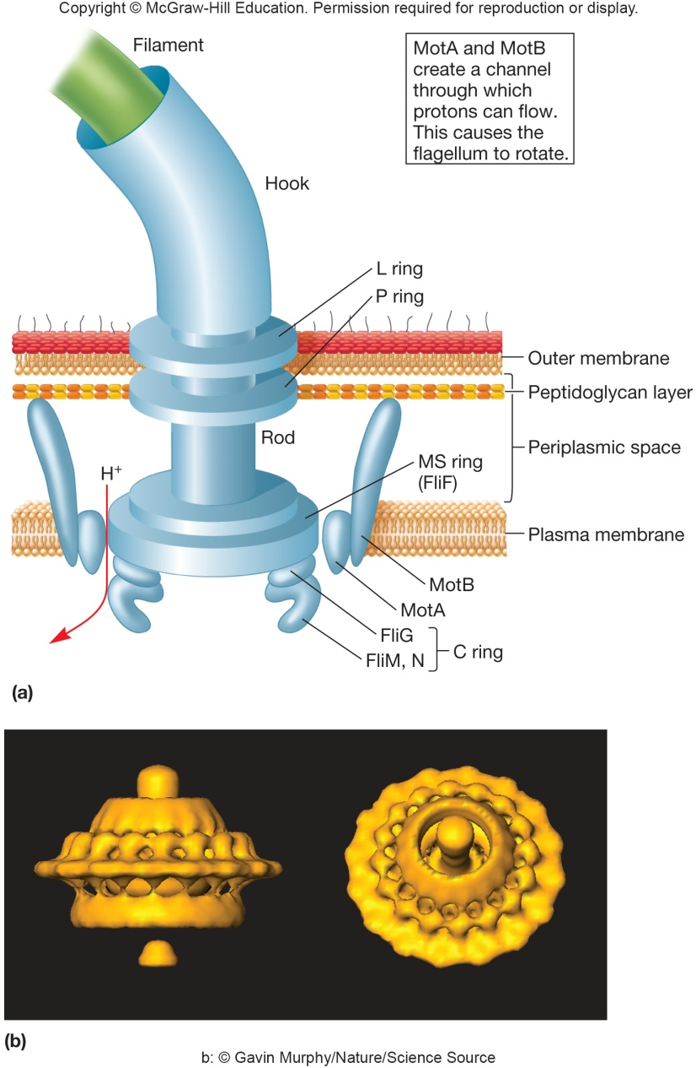
Mechanism of Flagellar Movement
Flagellum is 2 part motor producing torque
Rotor
C (FliG protein) ring and MS ring turn and interact with stator
Stator - Mot A and Mot B proteins
form channel through plasma membrane
protons move through Mot A and Mot B channels using energy of proton motive force
torque powers rotation of the basal body and filament

Slide 71
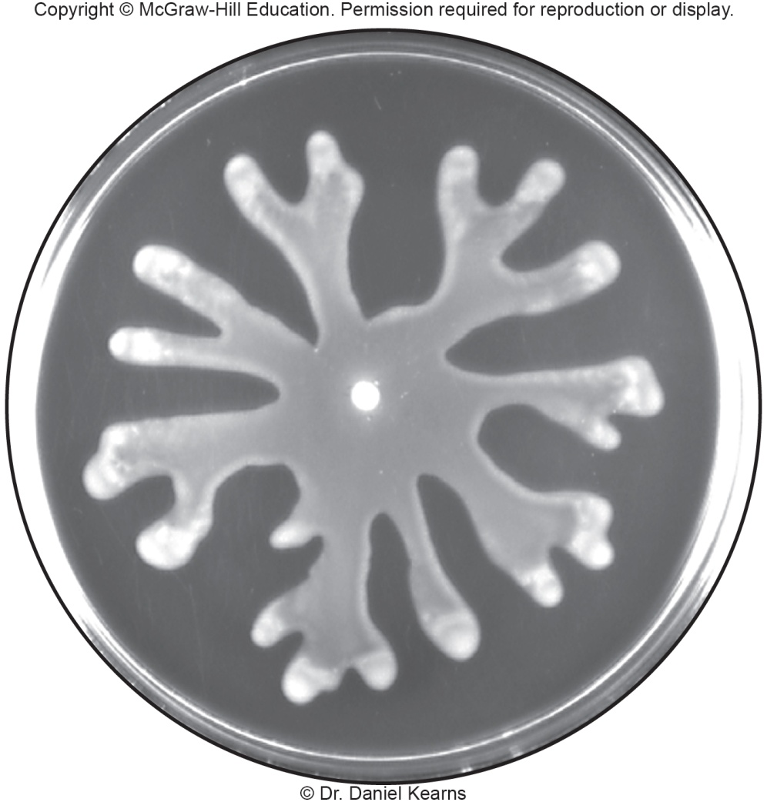
Swarming
Occurs on moist surfaces as a type of group behavior by bacteria
Most swarmers have peritrichous flagella
Production of molecules that aid movement is typical

Slide 72
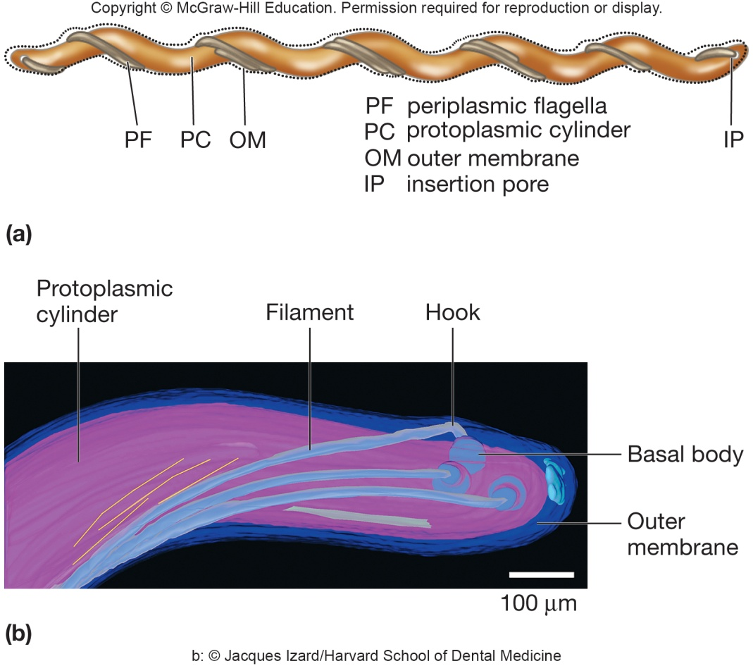
Spirochete Motility
Multiple flagella form axial fibril which winds around the cell
Flagella remain in periplasmic space inside outer sheath
Corkscrew shape exhibits flexing and spinning movements

Slide 73
Twitching and Gliding Motility
May involve Type IV pili and slime
Twitching
pili at ends of cell
short, intermittent, jerky motions
cells are in contact with each other and surface
Gliding
smooth movements

Slide 74
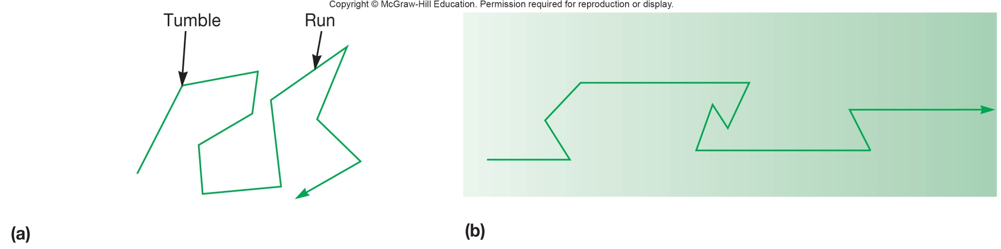
Chemotaxis
Movement toward a chemical attractant or away from a chemical repellent
Changing concentrations of chemical attractants and chemical repellents bind chemoreceptors of chemosensing system
In presence of attractant/repellant, tumbling frequency is reduced; runs toward/away from compound are longer
Behavior of bacterium altered by temporal concentration of chemical

Slide 75
3.9 Bacterial Endospores Are a Survival Strategy
Describe the structure of the bacterial endospore.
Explain why the bacterial endospores are of particular concern to the food industry and why endospore-forming bacteria are important model organisms.
Describe in general terms the process of sporulation.
Describe those properties of endospores that are thought to contribute to its resistance to environmental stresses.
Describe the three stages that transform an endospore into an active vegetative cell.

Slide 76
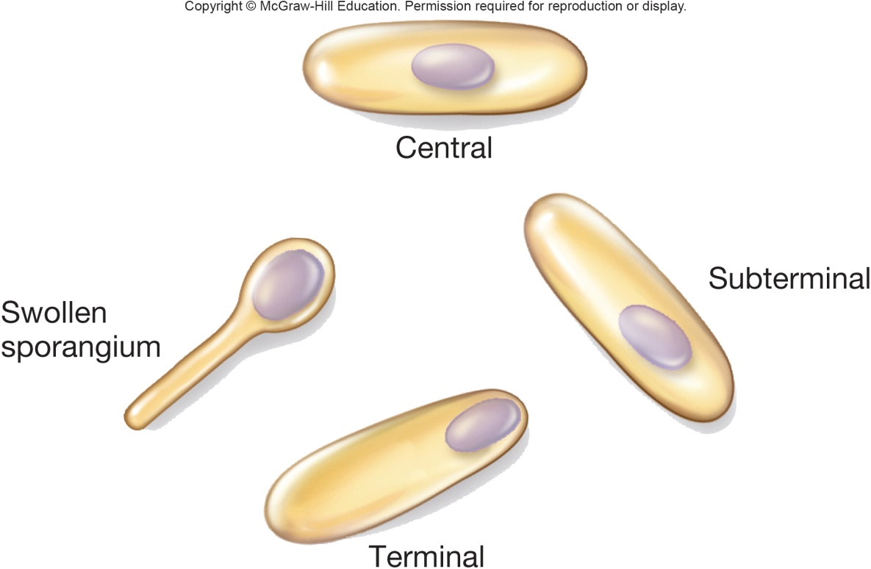
The Bacterial Endospore
Complex, dormant structure formed by some bacteria
Various locations within the cell
Resistant to numerous environmental conditions (including heat, radiation, chemicals, desiccation) due to
calcium (complexed with dipicolinic acid)
small, acid-soluble, DNA-binding proteins (SASPs)
dehydrated core
spore coat and exosporium protect

Slide 77
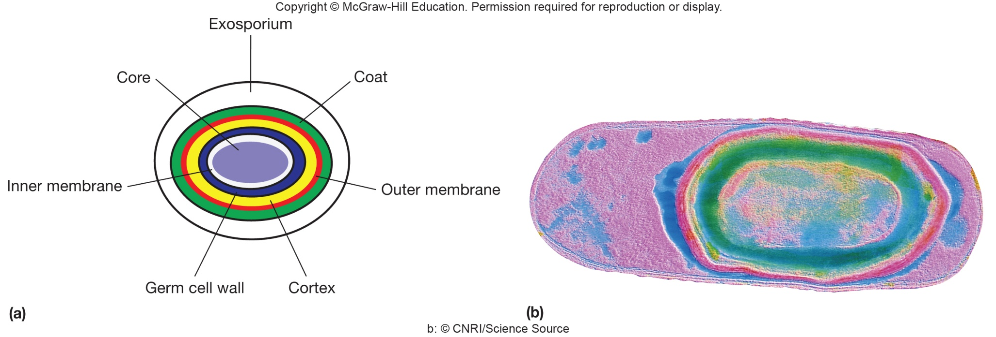
Endospore Structure
Spore surrounded by thin covering called exosporium
Thick layers of protein form the spore coat
Cortex, beneath the coat, thick peptidoglycan
Core has nucleoid and ribosomes

Slide 78
Sporulation
Process of endospore formation
Occurs in a hours (up to 10 hours)
Normally commences when growth ceases because of lack of nutrients
Complex multistage process

Slide 79
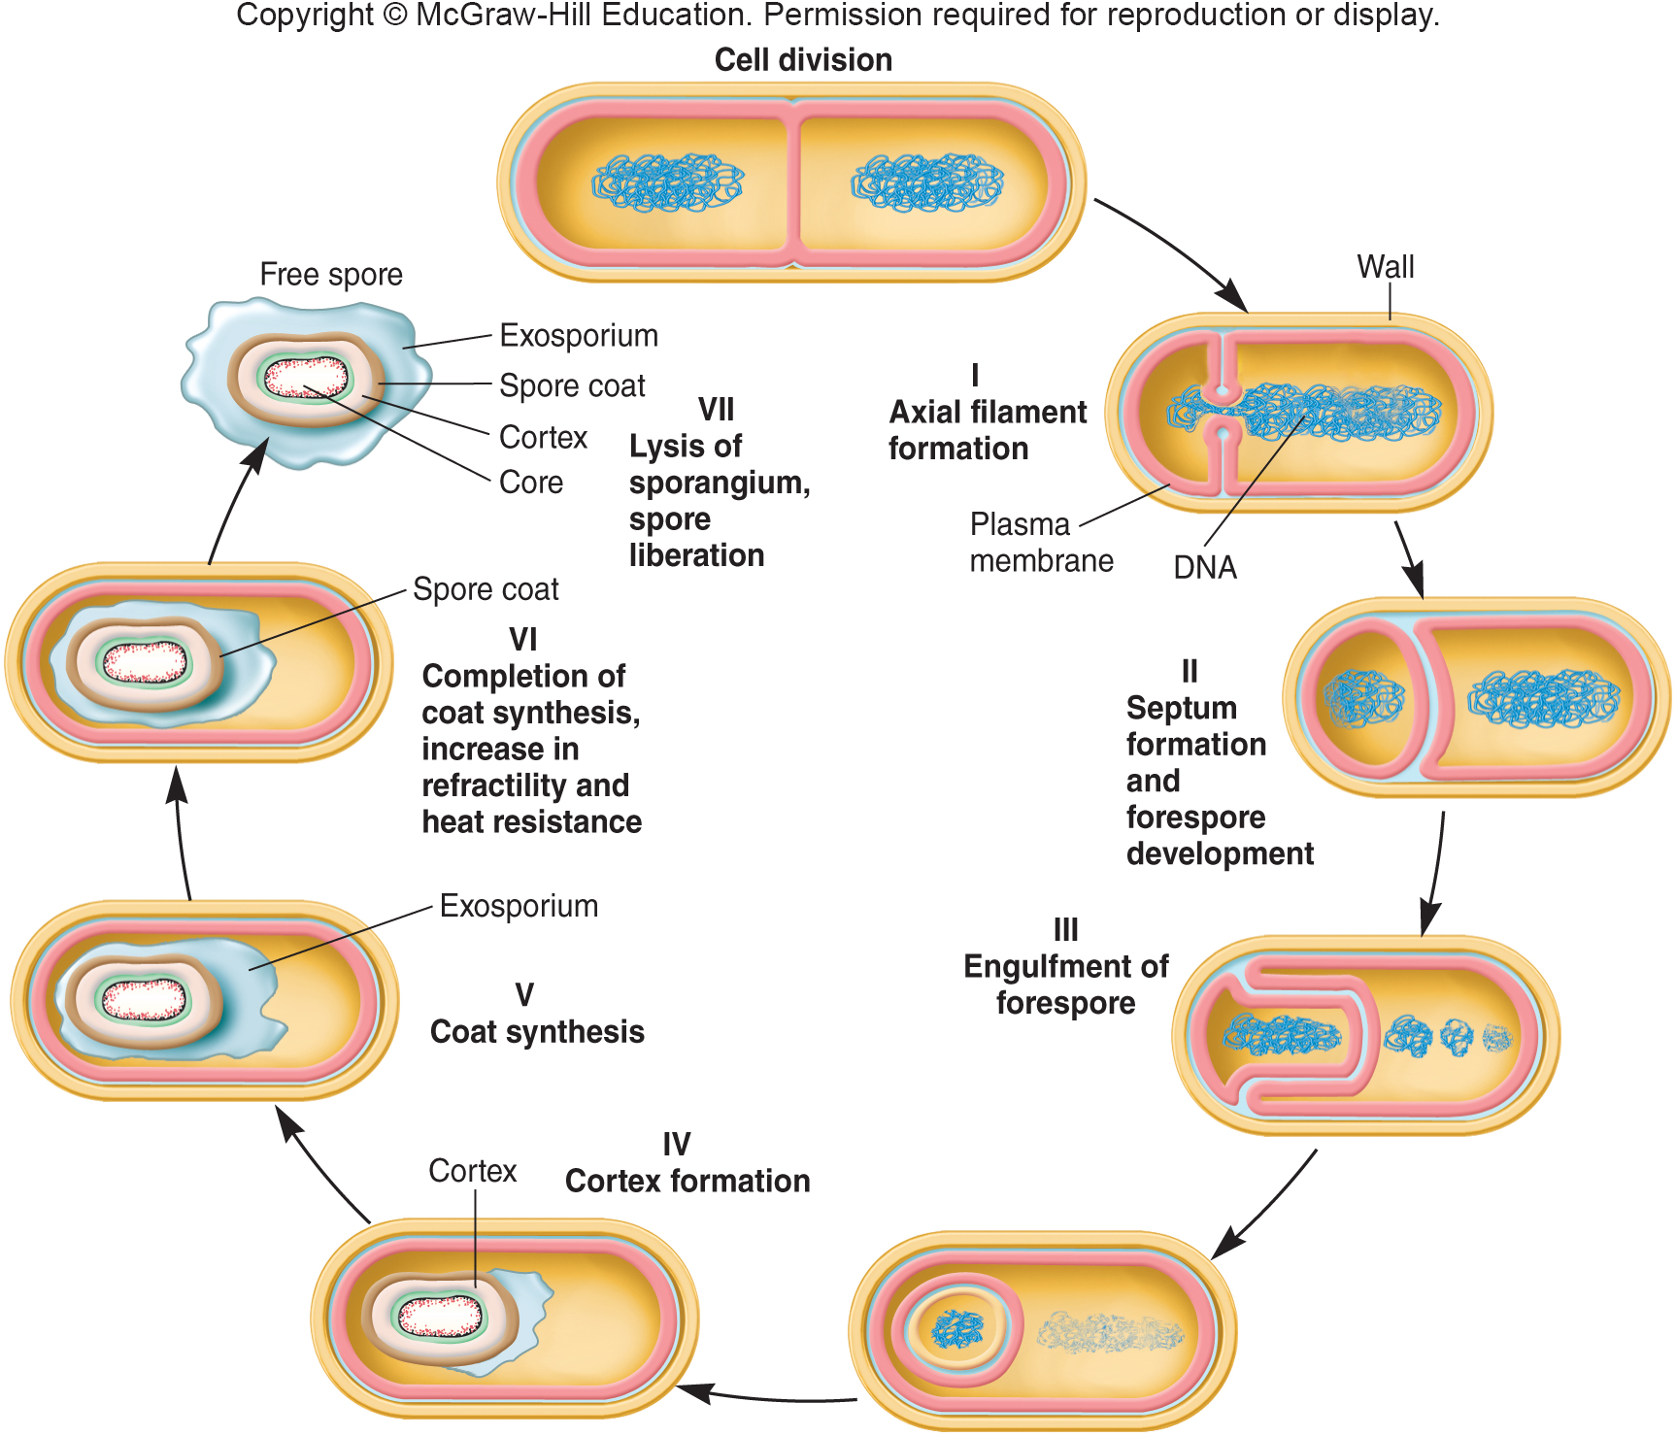
Sporulation Cycle

Slide 80
Formation of Vegetative Cell
Activation
prepares spores for germination
often results from treatments like heating
Germination
environmental nutrients are detected
spore swelling and rupture of absorption of spore coat
increased metabolic activity
Outgrowth - emergence of vegetative cell

Slide 81
Take-Home Message
Bacteria can have many different structures, but there are some fundamental items that are present in virtually all of them
As you continue on to examine the other two domains of life, be thinking about what is similar and what is different between them
Structure always determines function – so be thinking about how different cellular structures (bacterial in this case) give the cells particular functions for their particular environments or needs

